Slide 1

Talking to young people about vaping
A guide for parents and carers

Slide 2

Acknowledgement of Country
I acknowledge the Traditional Custodians of the lands that we are meeting on today. I pay my respects to Elders past and present and celebrate the diversity of Aboriginal peoples and their ongoing cultures and connections to the lands and waters of NSW.
I also acknowledge and pay my respects to our Aboriginal and Torres Strait Islander people/colleagues joining us today.
Artwork by Dennis Golding
Notes:
Facilitator notes:
Please add a new slide if you wish to include your own local or organisational acknowledgement.

Slide 3
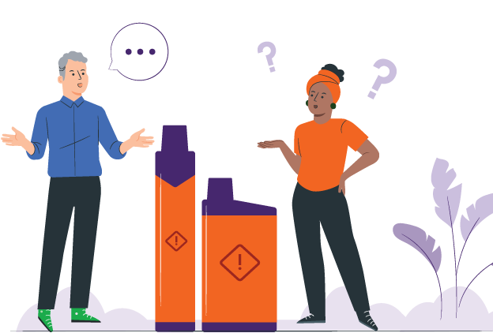
Introduction
Vaping has become more common in young people
Young people see vaping in different ways
This ranges from curiosity to making a choice to either vape or not vape
Parents and carers may not know what to say
This guide helps you have calm, supportive talks
Notes:
Facilitator notes:
Vaping has become more common, and young people come across it in different ways. Some might just be curious. Some see friends or classmates vaping. Some may already be vaping. Others are choosing not to vape.
This guide is for all these situations. It helps parents and carers talk with young people, no matter where they are at.
You do not need to have all the answers. This guide is about listening, staying calm, and keeping the conversation open. It can help you support your young person and build trust over time.

Slide 4
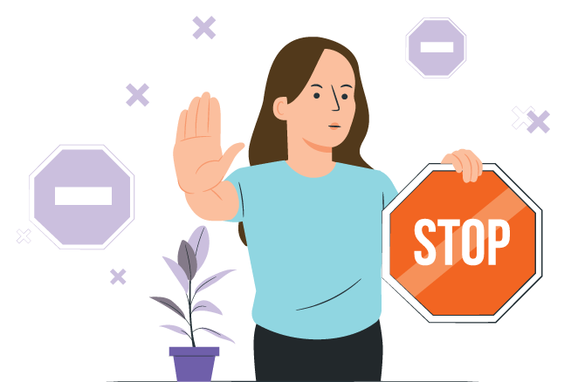
Purpose of this guide
Support parents and carers to talk safely and with respect about vaping
Prevent young people from starting to vape
Support young people to stop vaping
Build trust and open communication
Notes:
Facilitator notes:
The purpose of this guide is to support parents and carers to talk with young people about vaping in a safe and respectful way. It aims to encourage young people to avoid vaping, support those who may already be vaping to stop, and strengthen trust and communication. This guide is not about blaming or punishing young people.

Slide 5

How to use this guide
You do not need to use the whole guide at once
Talk about vaping over time
Choose the parts that fit your family and culture
It’s okay if it does not feel easy
Keep communication open and supportive
Notes:
Facilitator notes:
You don’t need to use the whole guide at once. Conversations about vaping can happen over time. Choose the parts that feel right for your family and your situation. It’s okay if things feel a bit awkward at first. What matters most is keeping the conversation open and supportive.

Slide 6

Quick facts: Chemicals in a vape
Most vapes contain nicotine
The nicotine in a 6,000 ‘puff’ vape can equal 400 cigarettes
Vapes contain harmful chemicals and heavy metals
These chemicals can hurt your lungs, heart and other organs
Vaping is not safe
Notes:
Facilitator notes:
Vapes contain nicotine and harmful chemicals
Nicotine is highly addictive and is found in most vapes
Regular use of nicotine often means people need more to get the same feeling from it. It can be hard to quit.
The nicotine in a 6,000 ‘puff’ vape can equal the same nicotine in 400 cigarettes
Vape liquid and aerosol contain harmful chemicals and metals like lead, nickel and chromium. These chemicals can damage the lungs, heart and other parts of the body. Some chemicals are also found in things like poisons and bug spray.

Slide 7

Quick facts: Health effects
Nicotine can damage your brain
It can make it harder to learn, focus, and manage your emotions
Vaping can lead to addiction and increase your chance of smoking cigarettes
The long-term harms of vaping are still being studied and may include increased cancer risk
Notes:
Facilitator notes:
Vaping puts harmful chemicals into the body, which can damage your brain and cause breathing problems.
Most vapes contain nicotine, which is very addictive and can affect brain development in teenagers, making it harder to learn, focus, remember things, and manage emotions.
Some young people have even needed hospital care because of vaping.
Using vapes and cigarettes together can increase harm.
Research is still developing, but vaping has been linked to lung injury, mouth and throat problems, and possible cancer risks.
The long-term harms are still being studied.

Slide 8

Quick facts: The law in Australia
People who have a vape for their own use are not targeted by the lawsYoung
People who have a vape for their own use are not targeted by the lawsYoung
Vapes can only legally be sold in pharmacies
People under 18 need a prescription
Most vapes sold in shops are illegal
People who vape for personal use won’t get in trouble
Vaping is banned in places where smoking is banned
Notes:
Facilitator notes:
In Australia:
Vapes can only legally be sold in pharmacies and should only be sold to help people quit smoking or to manage nicotine dependence.
People under 18 need a prescription to buy vapes from a pharmacy.
Shops such as tobacconists, service stations and convenience stores are banned from selling vapes.
People who have a vape for their own use are not targeted by the laws.
Vaping is banned in places where smoking is banned.
These laws apply across NSW and are in place to protect young people from addiction and health harm.

Slide 9

Tips for talking with young people
Stay calm and do not judge
Listen more than you talk
Ask open questions first, give advice later
Show you understand their feelings
Notes:
Facilitator notes:
When talking about vaping, staying calm and non‑judgemental can really help. Listening more than you talk shows your young person that you respect their thoughts and feelings. Even if you don’t fully agree, acknowledging how they feel can help them feel heard and more willing to listen.

Slide 10

Starting the conversation
Choose a calm and safe time to talk:
When side-by-side doing daily activities (cooking, walking)
When vaping comes up in school, social media or TV
When your child starts talking about it
Easy ways to start
“I see vaping a lot now. What do you think about it?”
“Have you seen or heard much about vapes?”
Notes:
Facilitator notes:
It can help to start these conversations during everyday moments, like driving, cooking, or going for a walk. Being side-by-side instead of opposite each other can feel less awkward. Try to keep the tone relaxed and curious. You might say something like, "I’ve been hearing about vaping lately and wanted to check in with you." Focusing on care rather than anger can help your young person open up.

Slide 11

Why young people might try vaping
Curiosity or wanting to experiment
Flavours and smells – sweet or fruity flavours
Peer pressure or wanting to fit in
Stress, anxiety or coping with emotions
Seeing vaping on social media makes it look normal
Notes:
Facilitator notes:
Young people may try vaping for many reasons, including curiosity, sweet and fruity flavours, peer pressure, stress, or seeing vaping on social media. Some are also drawn to the short-term “head spin” or “buzz,” beliefs that vaping can help with weight control or appetite suppression, or the sense of privacy if parents or caregivers are less likely to notice. It’s normal for young people to be curious and want to fit in, and many are still learning how to cope with stress. Trying vaping does not mean a young person is bad or naughty, and it doesn’t mean they will keep using it.
What matters is how adults respond. Listening without judging, staying calm, and trying to understand their reasons can help build trust and support helpful conversations.

Slide 12
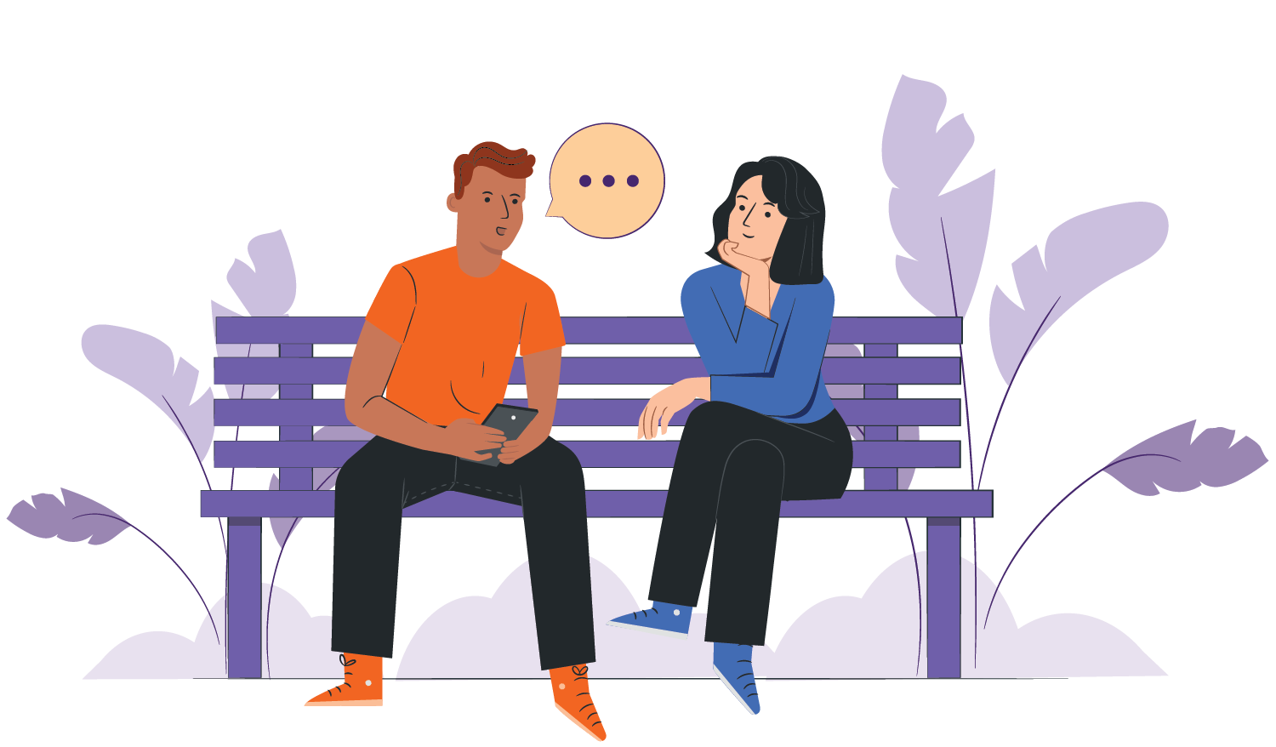
If your child is not vaping
Support their choice not to vape
Talk about managing peer pressure
Help them practise saying “No”
Tell them they can come to you anytime
Notes:
Facilitator notes:
If your young person is not vaping, this is a good chance to talk. Let them know you’re glad they’re not vaping and ask how they feel when others do. You can also practise simple responses like “No thanks, I don’t vape” or “I’m not into that” to help them feel confident saying no. These conversations can help them feel supported and prepared for situations where they may be offered a vape.

Slide 13
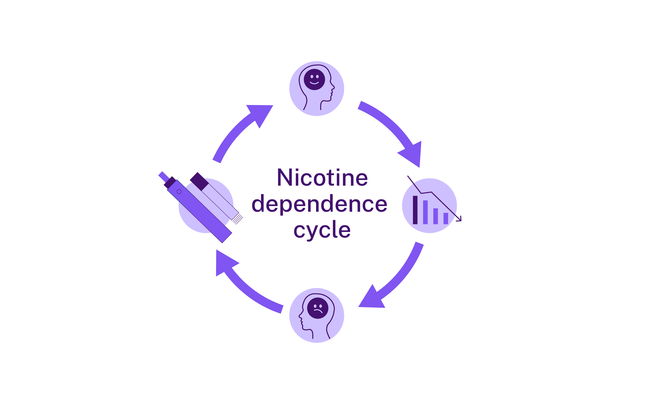
About nicotine & addiction
Nicotine is addictive and affects your brain
It can make quitting hard
Young brains are still growing
Addiction can happen fast
Nicotine makes the brain release dopamine, a ‘feel-good’ chemical
Nicotine reaches the brain by smoking or vaping
Dopamine levels drop, which causes withdrawal symptoms
Withdrawal increases the urge to smoke or vape again for more nicotine
Notes:
Facilitator notes:
Nicotine affects the brain by releasing a feel-good chemical called dopamine. This can make people want to keep vaping to feel that effect again. Over time, the brain gets used to nicotine, making it harder to quit. Signs of addiction may include cravings, mood changes, feeling restless, trouble concentrating, or wanting to vape soon after waking up. Because young people’s brains are still developing, nicotine can cause long-lasting changes.

Slide 14

Nicotine and withdrawal
Withdrawal symptoms can happen when the body does not get the nicotine it is used to
Withdrawal causes mood changes
Symptoms improve in 1–2 weeks
Cravings may last longer as the brain learns to cope without nicotine
If you smoke or vape:​
Being honest can help your young person. It shows you know how hard stopping is. Trying to be healthy sets a good example. Be kind to yourself. Change takes time. Getting help for yourself can also help your young person.
Notes:
Facilitator notes:
When someone stops vaping, they may experience withdrawal symptoms like feeling moody, tired, anxious or finding it hard to concentrate. Withdrawal can happen during school hours, on long trips, or anytime vaping isn’t possible. The good news is that physical withdrawal usually improves within one to two weeks. Cravings can last longer, but they do get easier over time.
Parent & carer content:
If you smoke or vape yourself:
Being honest about your own experience can help your young person feel understood
Be kind to yourself. Change takes time and getting help for your own health can help you both

Slide 15
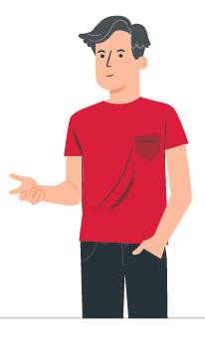
If your young person is vaping
Stay calm and listen
Thank them for being honest
Focus on their health and wellbeing, not punishment
Ask:
“What do you like about vaping?”
“Have you thought about stopping?”
“Do you want help with this?”
If you smoke or vape:
It’s okay to talk about your own habits. You can say you’re trying to stop too. This shows stopping is hard but possible. It helps your young person feel understood.
Notes:
Facilitator notes:
Finding out your young person is vaping can be upsetting. Taking a calm approach can make a big difference. Thanking them for being honest and focusing on health rather than punishment can help keep them talking and open to support. Some young people vape to cope with stress, anxiety, or fitting in, so it can help to encourage healthier options like exercise, creative activities, spending time with friends, or talking to a trusted adult.
Parent & carer content:
If you smoke or vape, it’s okay to talk about working on your own habits. You can use this as an opportunity to support your young person, by using phrases like “I’m trying to stop too” and acknowledge the difficulty.

Slide 16

Why young people may vape:
How to respond
Stress: Some young people vape to cope with stress
Fitting in: Friends who vape can create pressure
Curiosity: Trying vaping once can lead to regular use
Seeing it everywhere: Vaping can seem very common, especially online
Notes:
Facilitator notes:
Young people may vape for many reasons. Knowing why can help you to support them.
Stress:
Some young people think vaping helps them relax or manage stress. Parents and carers can support them to find healthier ways to cope, such as being active, doing something creative, or talking about how they’re feeling.
Fitting in:
Peer pressure plays a big role. Encourage parents to ask what their young person thinks they would miss if they didn’t vape, and to remind them that friendships are about shared interests and support, not vaping.
Curiosity:
Wanting to experiment is normal. It’s helpful to acknowledge this while explaining that nicotine is very addictive, and that vaping “just once” can quickly turn into vaping more than they expected.
Seeing it everywhere:
Vaping can look very common because of social media. Parents can share that around 80% of young people in NSW don’t vape, and many choose not to because it’s not harmless.

Slide 17
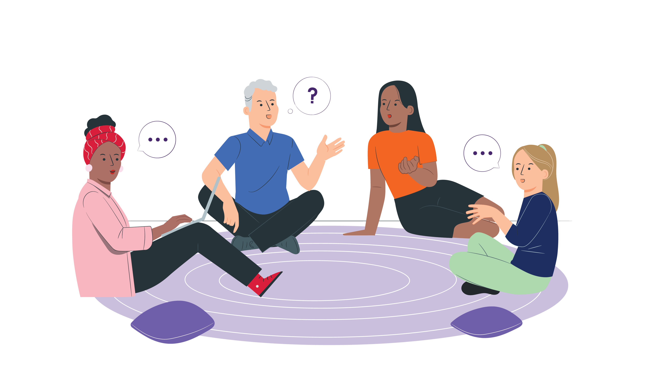
Supporting a young person to stop vaping
Encouraging small steps
Help them recognise triggers, and deal with cravings
Avoid judging them
Celebrate small wins
If they aren’t ready to stop, keep the conversation open
Notes:
Facilitator notes:
If they’re not ready to quit, focus on harm reduction and staying connected. This might include not vaping around others and planning for when they feel ready to make changes. Quitting can be hard, especially if nicotine addiction is involved, so encourage small steps and celebrate progress, even if it’s small. Relapse can happen and doesn’t mean failure. Ongoing support and trust really matter.
Parent & carer content:
Managing your own emotions
If you learn your young person is vaping, manage your feelings away from them
Strong reactions can make them shut down or pull away
Staying calm helps keep them open to support
If you smoke or vape, getting support can help you both

Slide 18

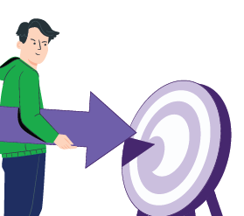


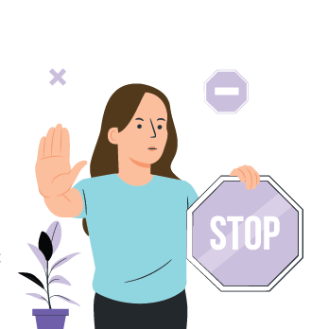

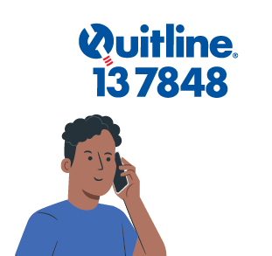

Where to get help and support
Pave
Free app for young people to stop vaping
Download Pave
NSW Vaping Toolkit
Trusted info for parents and carers
health.nsw.gov.au\vaping
iCanQuit
Free website to quit smoking or vaping
iCanQuit.com.au
Shisha No Thanks
Info about shisha harms
ShishaNoThanks.org.au
NSW Quitline
Free phone support with a trained counsellor
Call 13 7848
Notes:
Facilitator notes:
Support is available for both young people and families:
Pave is a free app created by Cancer Institute NSW to support young people who want to stop vaping. It provides tools and tips to help manage cravings and build confidence to quit. The app is designed specifically for young people and can be used independently or alongside other support. Download Pave from the Apple App Store or Google Play.
iCanQuit is a website that helps people stop smoking or vaping. It gives tools that you can choose to suit you. The website helps:
Make a quit plan
Stay motivated
Track your progress
Beat cravings
You can use iCanQuit on your own or with other support.
Quitline is a free and confidential phone service. It supports parents and carers as well as people who smoke or vape. Counsellors have been trained to listen without judgement and can help parents and carers to:
Start or continue conversations and handle tricky moments
Respond well if their young person is vaping
Advice is practical, respectful and tailored to each family’s situation. If you need an interpreter, they can arrange one for you when you call.
The NSW Health Vaping Toolkit is a NSW Health webpage with trusted information to help parents, carers, teachers and health staff talk to young people about vaping.
There are resources in different languages for parents and carers.
Shisha No Thanks is a website that helps adults learn about shisha (waterpipe) smoking. The website helps to:
Explain health harms
Clear up myths
Support talks with young people about shisha

Slide 19

Keeping talking
One conversation is usually not enough
Check in regularly
Keep listening and offering support
Ongoing, respectful conversations can:
  Reduce harm
  Help your young person to feel supported
Notes:
Facilitator notes:
Talking about vaping is not a one-off conversation. Checking in regularly and continuing to listen helps young people feel supported. These are guides, not rules, and every young person and family situation is different. Ongoing, respectful conversations can make a real difference and help reduce harm over time.

Slide 20

Key messages for parents and carers
You do not need to know everything about vaping
Your relationship with your young person matters most
Calm, open, conversations help
Listen more than you talk
You can get support too
Notes:
Facilitator notes:
The main message is simple: stay connected, stay calm, and keep talking. You are not alone, and there are services to help your family.

Slide 21

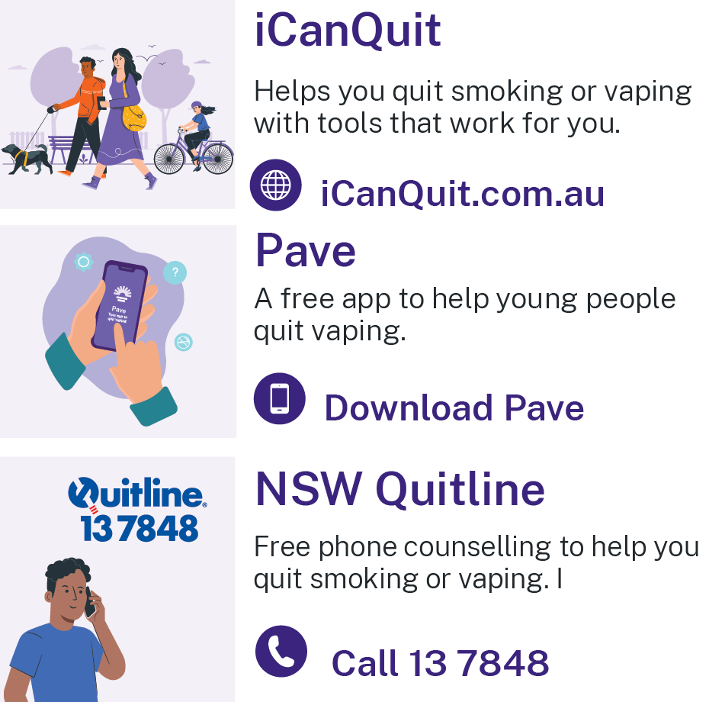
Resources
Pave app - Download Pave from the Apple App Store or Google Play
iCanQuit - iCanQuit.com.au
NSW Quitline - Call 13 78 48
NSW Health Vaping Toolkit - www.health.nsw.gov.au/vaping
Shisha No Thanks
ShishaNoThanks.org.au
Notes:
Facilitator notes:
Please add a new slide if you wish to include additional resources and support.
Quit support services:
Pave app
Download Pave from the Apple App Store or Google Play.
iCanQuit
iCanQuit is a website which has in-language resources available.
Quitline
Free call 13 78 48.
Interpreters are available.
NSW Health Vaping Toolkit
There are resources in different languages for parents and carers.
www.health.nsw.gov.au/vaping
Shisha No Thanks
Website - ShishaNoThanks.org.au

Slide 22
Thank you
Notes:
Facilitator note:
This email is for facilitators. If your group has any feedback on this presentation, please forward it to the Cancer Institute Prevention Team via email at CINSW-prevention@health.nsw.gov.au.

