Slide 1
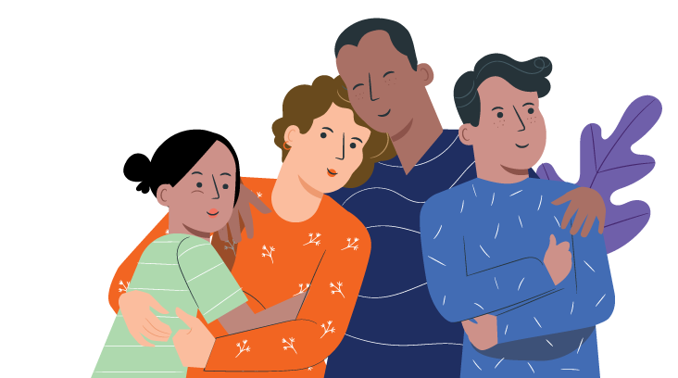
युवाहरूसँग vaping (भेपिङ)
को बारेमा कुराकानी
आमाबाबु र हेरचाहकर्ताहरूका लागि
निर्देशिका

Slide 2

भूमिको स्वीकारोक्ति (Acknowledgement of Country)
म आज हामी भेटघाट भै रहेको भूमिका परम्परागत संरक्षकहरूलाई आदरपूर्वक स्वीकार गर्दछु। म विगत र वर्तमान अग्रजहरूप्रति सम्मान
व्यक्त गर्दछु र आदिवासी मानिसहरूको विविधता र उनीहरूको हालको संस्कृति र NSW को जल र जमिनसँगको सम्बन्धको उत्सव मनाउँछु।
आज हामीसँग सामेल हुनुहुने हाम्रा एबोरिजिनल र टोरेस स्ट्रेट आइल्याण्डरका मानिसहरू/सहकर्मीहरूलाई पनि म स्वीकार
र सम्मान गर्छु।
डेनिस गोल्डिङको कलाकृति
Notes:
Facilitator notes:
Please add a new slide if you wish to include your own local or organisational acknowledgement.

Slide 3
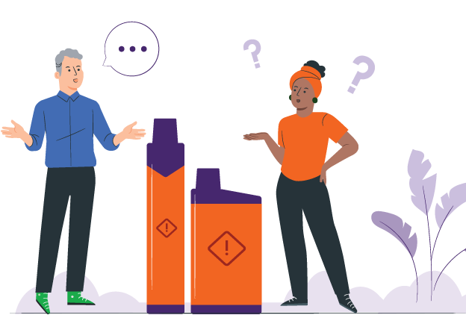
परिचय
Vaping (भेपिङ) धेरै सामान्य भै सकेको छ
युवाहरूले Vaping (भेपिङ) लाई फरक फरक तरिकाले हेर्छन्
यो जिज्ञासा बाट सुरु हुँदै Vaping (भेपिङ) गर्ने वा नगर्ने कुरा सम्म पुग्छ
आमाबाबु र हेरचाहकर्ताहरूलाई के भन्ने थाहा नहुन सक्छ
यो निर्देशिकाले तपाईंलाई सरल र शिष्ट कुराकानी सुरु गराउन मद्दत गर्छ
Notes:
Facilitator notes:
Vaping has become more common, and young people come across it in different ways. Some might just be curious. Some see friends or classmates vaping. Some may already be vaping. Others are choosing not to vape.
This guide is for all these situations. It helps parents and carers talk with young people, no matter where they are at.
You do not need to have all the answers. This guide is about listening, staying calm, and keeping the conversation open. It can help you support your young person and build trust over time.

Slide 4
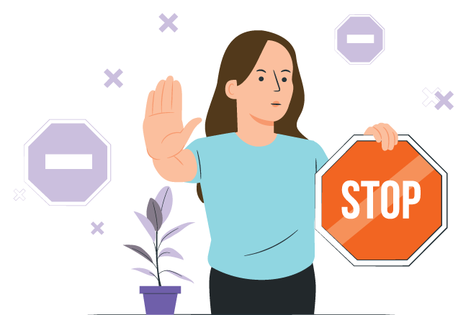
यस निर्देशिकाको उद्देश्य
आमाबाबु र हेरचाहकर्ताहरूलाई Vaping (भेपिङ) को बारेमा सुरक्षित र सम्मानपूर्वक कुराकानी गराउन सहयोग गर्ने
युवाहरूलाई Vaping (भेपिङ) सुरु
गर्नबाट रोक्ने
Vaping (भेपिङ) छुटाउन युवाहरूलाई सहयोग गर्ने
विश्वास निर्माण गर्ने र खुला छलफल गर्ने
Notes:
Facilitator notes:
The purpose of this guide is to support parents and carers to talk with young people about vaping in a safe and respectful way. It aims to encourage young people to avoid vaping, support those who may already be vaping to stop, and strengthen trust and communication. This guide is not about blaming or punishing young people.

Slide 5
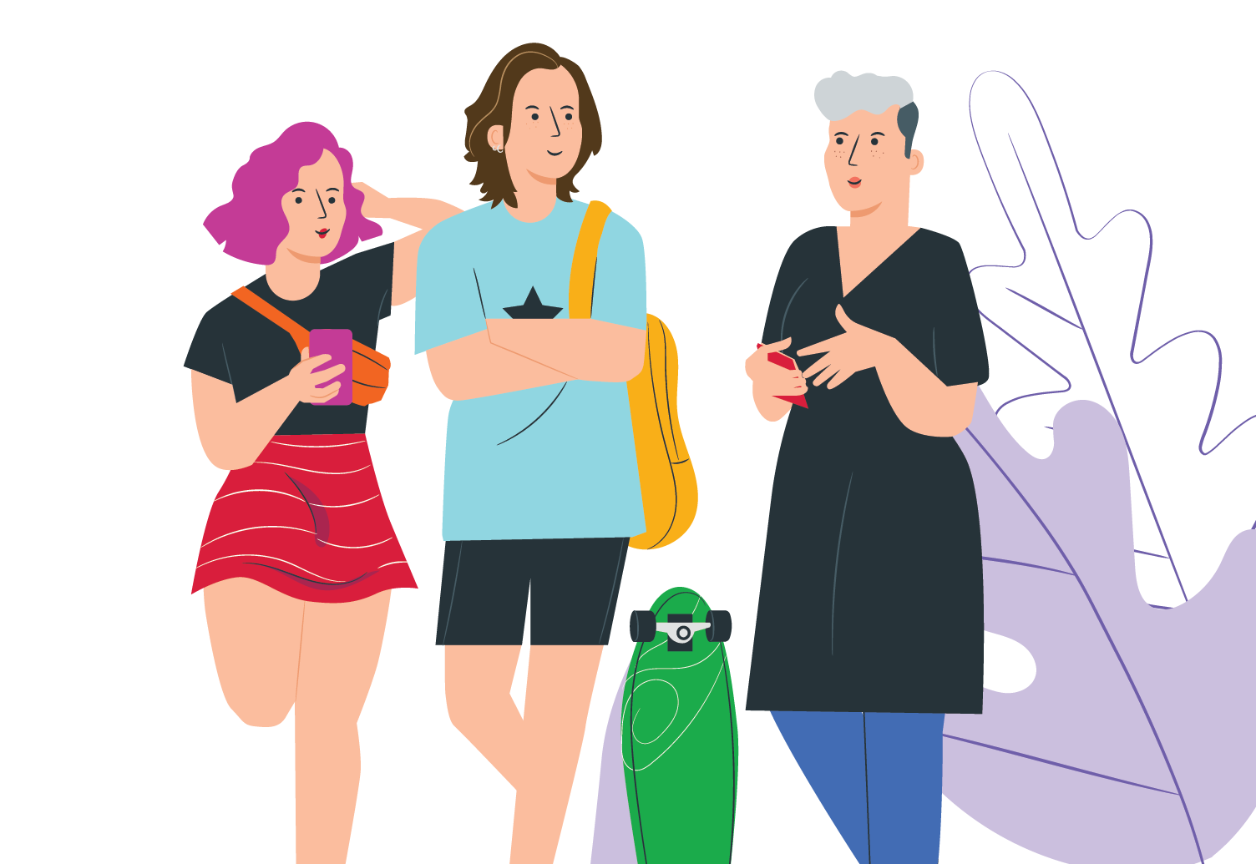
यो निर्देशिका कसरी प्रयोग गर्ने
तपाईंले यो निर्देशिका सबै एकैचोटि प्रयोग गर्नु पर्दैन
Vaping (भेपिङ) को बारेमा समय समयमा कुराकानी गर्नुहोस्
आफ्नो परिवार र संस्कृतिसँग मिल्दोजुल्दो अंशहरू प्रयोग गर्नुहोस्
कुराकानी गर्दा अप्ठ्यारो वा असहज महसुस हुनु स्वाभाविक हो
कुराकानी खुला राख्नुहोस् र सहयोगी ढङ्गले कुरा गर्नुहोस्
Notes:
Facilitator notes:
You don’t need to use the whole guide at once. Conversations about vaping can happen over time. Choose the parts that feel right for your family and your situation. It’s okay if things feel a bit awkward at first. What matters most is keeping the conversation open and supportive.

Slide 6

संक्षिप्त तथ्यहरू: Vape (भेप) मा हुने रसायनहरू
धेरैजसो Vape (भेप) हरूमा निकोटिन हुन्छ
६,००० 'सर्को' Vape (भेप) मा रहेको निकोटिन ४०० चुरोट बराबर हुन सक्छ
Vape (भेप) हरूमा हानिकारक रसायन र भारी धातुहरू हुन्छन्
यी रसायनहरूले तपाईंको फोक्सो, मुटु र
अन्य अंगहरूलाई हानि पुर्‍याउन सक्छन्
Vaping (भेपिङ) ले हानि गर्छ
Notes:
Facilitator notes:
Vapes contain nicotine and harmful chemicals
Nicotine is highly addictive and is found in most vapes
Regular use of nicotine often means people need more to get the same feeling from it. It can be hard to quit.
The nicotine in a 6,000 ‘puff’ vape can equal the same nicotine in 400 cigarettes
Vape liquid and aerosol contain harmful chemicals and metals like lead, nickel and chromium. These chemicals can damage the lungs, heart and other parts of the body. Some chemicals are also found in things like poisons and bug spray.

Slide 7

संक्षिप्त तथ्यहरू: स्वास्थ्यमा असरहरू
Vaping (भेपिङ) गर्दा फोक्सोमा रसायनहरू पुग्छ र श्वासप्रश्वासमा समस्या निम्त्याउँछ
निकोटिनले तपाईंको मस्तिष्कलाई हानि पुर्‍याउन सक्छ
यसले सिक्न, ध्यान केन्द्रित गर्न र आफ्ना भावहरू व्यवस्थापन गर्न गाह्रो बनाउन सक्छ
Vaping (भेपिङ) ले लत लगाउन सक्छ र चुरोट सेवन गर्ने सम्भावना बढाउन सक्छ
Notes:
Facilitator notes:
Vaping puts harmful chemicals into the body, which can damage your brain and cause breathing problems.
Most vapes contain nicotine, which is very addictive and can affect brain development in teenagers, making it harder to learn, focus, remember things, and manage emotions.
Some young people have even needed hospital care because of vaping.
Using vapes and cigarettes together can increase harm.
Research is still developing, but vaping has been linked to lung injury, mouth and throat problems, and possible cancer risks.
The long-term harms are still being studied.

Slide 8

संक्षिप्त तथ्यहरू: यस सम्बन्धमा अष्ट्रेलियाको कानून
आफ्नै प्रयोगका लागि Vape (भेप) राखेका मानिसहरूलाई कानूनले लक्षित गर्दैन।
आफ्नै प्रयोगका लागि Vape (भेप) राखेका मानिसहरूलाई कानूनले लक्षित गर्दैन।
Vape (भेप) हरू कानुनी रूपमा फार्मेसीहरूमा मात्र बेच्न पाइन्छ
१८ वर्ष मुनिका मानिसहरूलाई प्रिस्क्रिप्शन चाहिन्छ
पसलहरूमा बेचिने अधिकांश Vape (भेप) हरू अवैध छन्
व्यक्तिगत प्रयोगको लागि Vape (भेप) गर्ने मानिसहरू समस्यामा पर्ने छैनन्
धुम्रपान निषेधित ठाउँहरूमा Vaping (भेपिङ) निषेध गरिएको हुन्छ
Notes:
Facilitator notes:
In Australia:
Vapes can only legally be sold in pharmacies and should only be sold to help people quit smoking or to manage nicotine dependence.
People under 18 need a prescription to buy vapes from a pharmacy.
Shops such as tobacconists, service stations and convenience stores are banned from selling vapes.
People who have a vape for their own use are not targeted by the laws.
Vaping is banned in places where smoking is banned.
These laws apply across NSW and are in place to protect young people from addiction and health harm.

Slide 9

युवाहरूसँग कुराकानी गर्नको लागि सुझावहरू
शान्त रहनुहोस् र पूर्वाग्रह नराख्नुहोस्
बोल्नु भन्दा बढी सुन्नुहोस्
सर्वप्रथम खुला प्रश्नहरू सोध्नुहोस्
उनीहरूको भावना बुझेको अनुभूति गराउनुहोस्
Notes:
Facilitator notes:
When talking about vaping, staying calm and non‑judgemental can really help. Listening more than you talk shows your young person that you respect their thoughts and feelings. Even if you don’t fully agree, acknowledging how they feel can help them feel heard and more willing to listen.

Slide 10
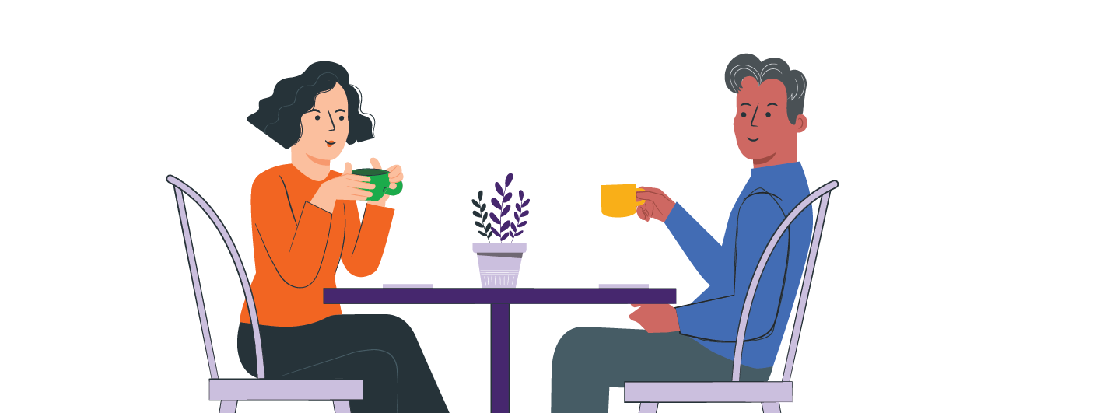
कुराकानीको सुरुवात
कुराकानी गर्नको लागि शान्त र सुरक्षित समय छान्नुहोस्:
सँगसँगै भएर दैनिक क्रियाकलापहरू गर्दा
(खाना पकाउदा, हिँड्दा)
विद्यालय, सामाजिक सञ्जाल वा टिभीमा
Vaping (भेपिङ) बारे चर्चा हुँदा
तपाईंको बच्चाले यसको
बारेमा कुरा गर्दा
कुराकानी सुरु गर्ने सजिला तरिकाहरू
"मैले आजभोलि Vaping (भेपिङ) गरिरहेका धेरै देख्छु। यसको बारेमा तिमीलाई के लाग्छ?"
"के तिमीले पनि Vape (भेप) को बारेमा धेरै सुन्छौँ वा देख्छौँ?"
Notes:
Facilitator notes:
It can help to start these conversations during everyday moments, like side-by-side activities instead of opposite each other (driving, cooking, or going for a walk). Try to keep the tone relaxed and curious. You might say something like, "I’ve been hearing about vaping lately and wanted to check in with you." Focusing on care rather than anger can help your young person open up.

Slide 11

युवाहरूले किन Vaping (भेपिङ) गर्ने प्रयास गर्न सक्छन्
उत्सुकता/कौतूहल
गुलियो वा फलफूलको स्वाद
साथीहरूको दबाब वा अरूसँग घुलमिल
हुने चाहना
तनाव, चिन्ता वा भाव नियन्त्रण
सामाजिक सञ्जालमा Vaping (भेपिङ) गरेको देख्दा यो सामान्य हो जस्तो लग्न सक्छ
Notes:
Facilitator notes:
Young people may try vaping or shisha or other nicotine products for many reasons, including curiosity, sweet and fruity flavours, peer pressure, stress, or seeing vaping on social media. Some are also drawn to the short-term “head spin” or “buzz,” beliefs that vaping can help with weight control or appetite suppression, or the sense of privacy if parents or caregivers are less likely to notice. It’s normal for young people to be curious and want to fit in, and many are still learning how to cope with stress. Trying vaping does not mean a young person is bad or naughty, and it doesn’t mean they will keep using it.
What matters is how adults respond. Listening without judging, staying calm, and trying to understand their reasons can help build trust and support helpful conversations.

Slide 12
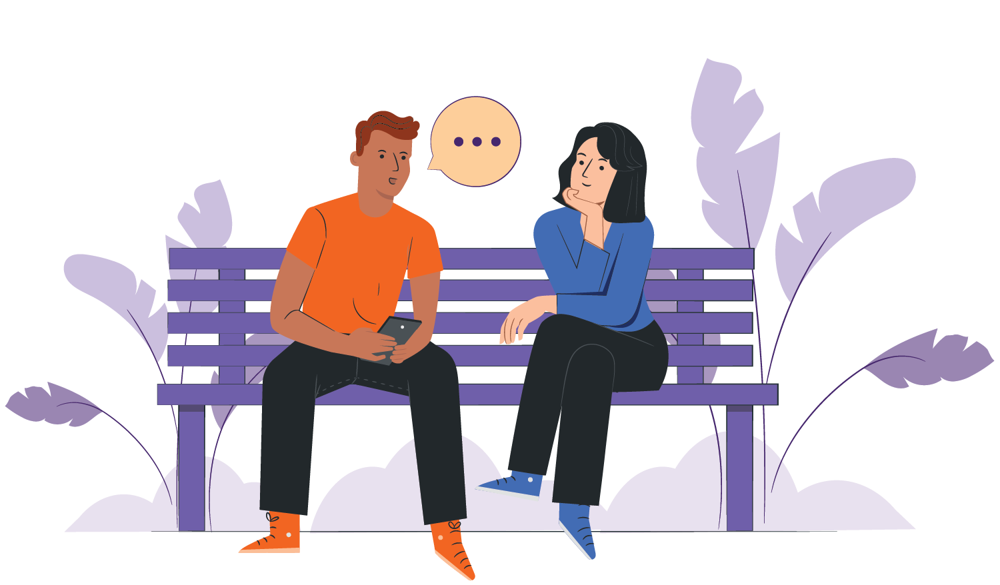
यदि तपाईंको बच्चाले Vaping (भेपिङ) गरिरहेको छैन भने
Vaping (भेपिङ) नगर्ने उनीहरूको निर्णयलाई समर्थन गर्नुहोस्
साथीहरूको दबाब व्यवस्थापन गर्ने
बारेमा कुरा गर्नुहोस्
उनीहरूलाई "नाई" भन्ने अभ्यास
गराउन मद्दत गर्नुहोस्
उनीहरू तपाईंसँग जुनसुकै
बेला कुराकानी गर्न सक्ने
कुरा बताउनुहोस्
Notes:
Facilitator notes:
If your young person is not vaping, this is a good chance to talk. Let them know you’re glad they’re not vaping and ask how they feel when others do. You can also practise simple responses like “No thanks, I don’t vape” or “I’m not into that” to help them feel confident saying no. You can also suggest it is fine for them to walk away too. These conversations can help them feel supported and prepared for situations where they may be offered a vape.

Slide 13
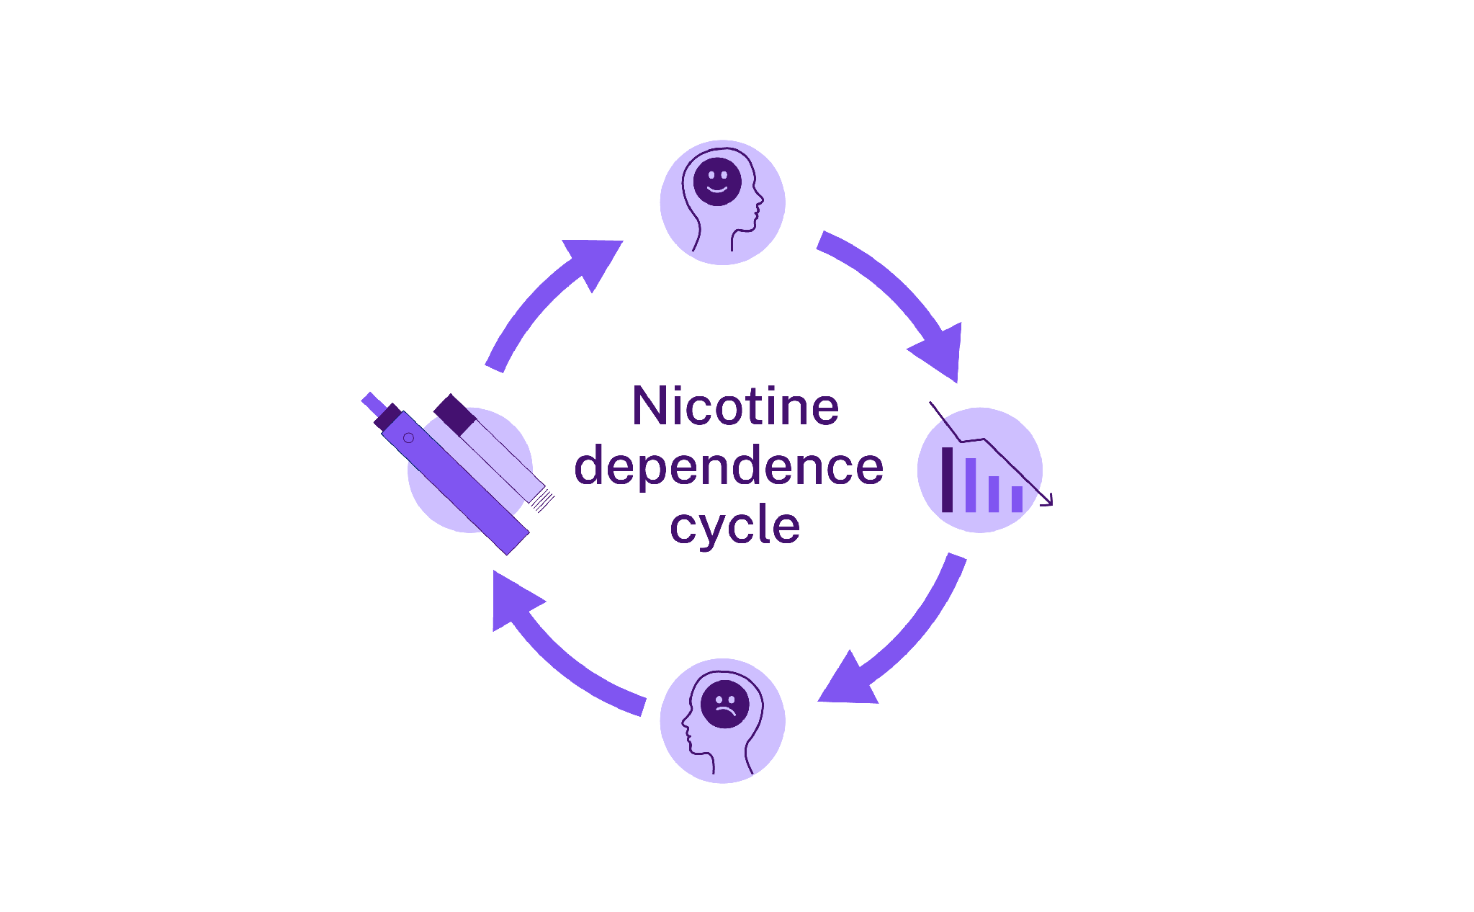
निकोटिन र लत
निकोटिनले मस्तिष्कलाई डोपामाइन उत्सर्जन गर्न सघाउँछ, जुन 'आनन्द महसुस गराउने' रसायन हो
निकोटिन लत लाग्ने पदार्थ हो र यसले तपाईंको मस्तिष्कलाई असर गर्छ
यसले Vape (भेप) छुटाउन गाह्रो बनाउन सक्छ
युवाहरुको मस्तिष्क विकासको क्रम अघि बढिरहेको हुन्छ
छिटो लत लाग्न सक्छ
धूम्रपान वा Vaping (भेपिङ) मार्फत निकोटिन मस्तिष्क सम्म पुग्छ
निकोटिन निर्भरता चक्र
डोपामाइनको मात्रा घट्छ, जसले गर्दा तलतल
लाग्न सक्छ
तलतलले गर्दा थप निकोटिनको मात्राका लागि धुम्रपान वा Vape (भेप) गर्ने इच्छा बढाउँछ
Notes:
Facilitator notes:
Nicotine affects the brain by releasing a feel-good chemical called dopamine. This can make people want to keep vaping to feel that effect again. Over time, the brain gets used to nicotine, making it harder to stop. Signs of addiction may include cravings, mood changes, feeling restless, trouble concentrating, or wanting to vape soon after waking up. Because young people’s brains are still developing, nicotine can cause long-lasting changes.

Slide 14

निकोटिन र तलतल
शरीरले अभ्यस्त भएको निकोटिन नपाउँदा छट्पटी हुन्छ
तलतलले मुड परिवर्तन गराउँछ
१-२ हप्तामा लक्षणहरूमा सुधार हुन्छ
तलतल लामो समयसम्म रहन सक्छ
यदि तपाईं धुम्रपान वा Vap (भेप) गर्नुहुन्छ भने:
इमानदार हुनाले तपाईंका किशोरकिशोरीलाई सहयोग
पुग्न सक्छ। यसले तपाईंलाई
यो छोड्न कति गाह्रो हुन्छ भन्ने कुरा देखाउँछ। स्वस्थ रहने प्रयास गर्नु राम्रो उदाहरण हो। आफैंप्रति इमानदार हुनुहोस्। परिवर्तन हुन समय लाग्छ। आफ्नै लागि
मद्दत खोज्नले तपाईंका किशोरकिशोरीलाई पनि
मद्दत पुग्न सक्छ।
Notes:
Facilitator notes:
When someone stops vaping, they may experience withdrawal symptoms like feeling moody, tired, anxious or finding it hard to concentrate. Withdrawal can happen during school hours, on long trips, or anytime vaping isn’t possible. The good news is that physical withdrawal usually improves within one to two weeks. Cravings can last longer as the brain learns to cope without nicotine, but it does get easier over time.
Parent & carer content:
If you smoke or vape yourself:
Being honest about your own experience can help your young person feel understood
Be kind to yourself. Change takes time and getting help for your own health can help you both

Slide 15
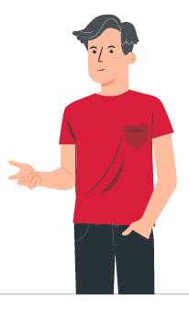
यदि तपाईंको बच्चाले Vaping (भेपिङ)
गरिरहेको छ भने
शान्त रहनुहोस् र सुन्नुहोस्
इमानदार भएकोमा उनीहरूलाई धन्यवाद दिनुहोस्
उनीहरूको स्वास्थ्यमा ध्यान दिनुहोस्, सजायमा होइन
उनीहरूलाई सोध्नुहोस्:
"तिमीलाई Vaping (भेपिङ) को बारेमा के
मन पर्छ?"
"के तिमीले यो छोड्ने बारेमा सोचेको छौँ ?"
"के तिमीलाई यस सम्बन्धमा सहयोग चाहिन्छ?"
यदि तपाईं धुम्रपान वा Vape (भेप) गर्नुहुन्छ भने:
आफ्नो बानीको बारेमा कुरा गर्नु बेठीक होइन। तपाईं पनि यो छोड्न खोज्दै गरेको कुरा सुनाउन सक्नुहुन्छ। यसले छोड्न गाह्रो हुन्छ तर सम्भव छ भन्ने कुरा संकेत गर्दछ। यसले किशोरकिशोरीको कुरा बुझ्नुहुन्छ भन्ने पनि महसुस गराउन मद्दत गर्छ।
Notes:
Facilitator notes:
Finding out your young person is vaping can be upsetting. Taking a calm approach can make a big difference. Thanking them for being honest and focusing on health rather than punishment can help keep them talking and open to support. Some young people vape to cope with stress, anxiety, or fitting in, so it can help to encourage healthier options like exercise, creative activities, spending time with friends, or talking to a trusted adult.

Slide 16
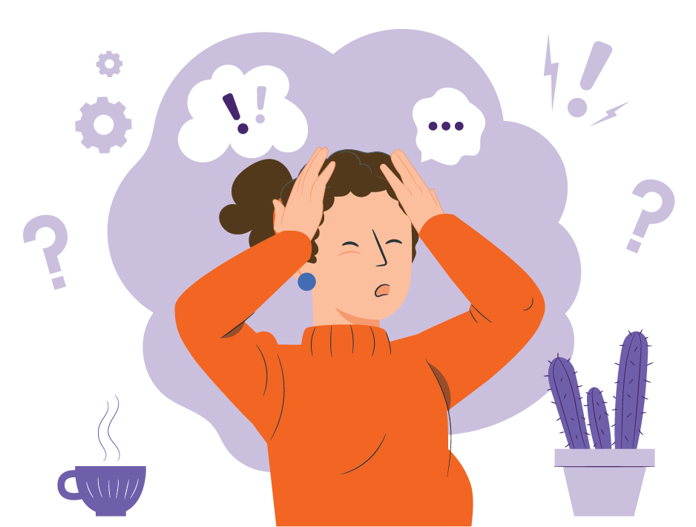
युवाहरूले किन Vaping (भेपिङ) गर्न सक्छन्:
कसरी प्रतिक्रिया जनाउने
तनाव: केही युवाहरू तनावमा हुँदा Vaping (भेपिङ) गर्छन्
घुलमिल हुनु: साथीहरूले युवाहरूलाई Vaping (भेपिङ) गर्न दबाब दिन सक्छन्
जिज्ञासा: Vaping (भेपिङ) को स्वाद लिँदा बानी बस्न सक्छ
जताततै देखिनु: अनलाइनमा Vaping (भेपिङ) सामान्य देखिन सक्छ
Notes:
Facilitator notes:
Young people may vape for many reasons. Knowing why can help you to support them.
Stress:
Some young people vape to cope with stress. Parents and carers can support them to find healthier ways to relax, like exercise, doing something creative, or talking about their feelings.
Fitting in:
Peer pressure can be strong. Remind young people that real friendships are about shared interests and support, not vaping.
Curiosity:
Trying new things is normal, but nicotine is very addictive. Even vaping “just once” can quickly turn into a habit or vaping more than they expected.
Seeing it everywhere:
Social media can make vaping seem normal or common, but around 80% of young people in NSW don’t vape, and many choose not to because it’s not harmless.

Slide 17
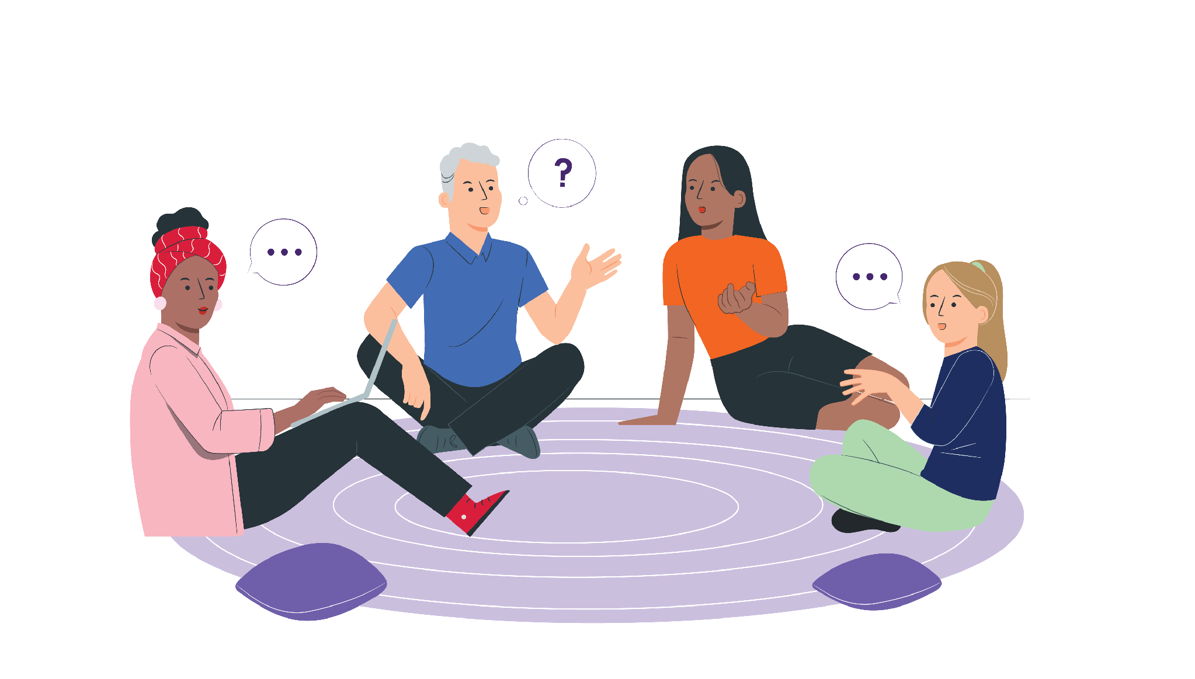
युवा लाई Vaping (भेपिङ) छुटाउन सहायता
स-साना कदमहरूलाई समर्थन गर्ने
तलतल हटाउन सहयोग गर्ने
उनीहरू प्रति पूर्वाग्रह नराख्ने
स-साना प्रगतिहरूमा खुशी हुने
यदि उनीहरू छोड्न तयार छैनन् भने, कुराकानी अन्त्य नगर्नुहोस्
Notes:
Facilitator notes:
If they’re not ready to quit, focus on harm reduction and staying connected. This might include not vaping around others and planning for when they feel ready to make changes. Quitting can be hard, especially if nicotine addiction is involved, so encourage small steps and celebrate progress, even if it’s small. Relapse can happen and doesn’t mean failure. Ongoing support and trust really matter.
Parent & carer content:
Managing your own emotions
If you learn your young person is vaping, manage your feelings away from them
Strong reactions can make them shut down or pull away
Staying calm helps keep them open to support
If you smoke or vape, getting support can help you both

Slide 18

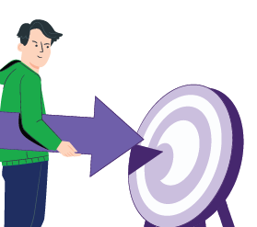


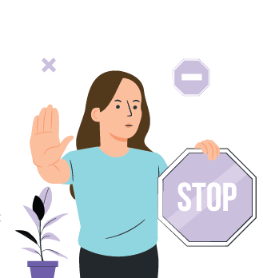



सहायता र समर्थन कहाँबाट लिने
Pave (पेभ)
युवाहरूलाई Vaping (भेपिङ) छुटाउनको लागि नि:शुल्क एप
Pave (पेभ) डाउनलोड गर्नुहोस्
NSW Vaping Toolkit
आमाबाबु र हेरचाहकर्ताहरूका लागि विश्वसनीय जानकारी
health.nsw.gov.au\vaping
iCanQuit
धूम्रपान वा Vaping (भेपिङ) छोड्न सहयोगको लागि नि:शुल्क वेबसाइट
iCanQuit.com.au/Nepali
Shisha No Thanks
हुक्काको हानि बारे जानकारी
ShishaNoThanks.org.au
NSW Quitline
प्रशिक्षित परामर्शदाता सहितको नि:शुल्क फोन सहायता
फोन 13 7848
Notes:
Facilitator notes:
Support is available for both young people and families:
Pave is a free app created by Cancer Institute NSW to support young people who want to stop vaping. It provides tools and tips to help manage cravings and build confidence to quit. The app is designed specifically for young people and can be used independently or alongside other support. Download Pave from the Apple App Store or Google Play.
iCanQuit is a website that helps people stop smoking or vaping. It gives tools that you can choose to suit you. The website helps:
Make a quit plan
Stay motivated
Track your progress
Beat cravings
You can use iCanQuit on your own or with other support.
Quitline is a free and confidential phone service. It supports parents and carers as well as people who smoke or vape. Counsellors have been trained to listen without judgement and can help parents and carers to:
Start or continue conversations and handle tricky moments
Respond well if their young person is vaping
Advice is practical, respectful and tailored to each family’s situation. If you need an interpreter, they can arrange one for you when you call.
The NSW Health Vaping Toolkit is a NSW Health webpage with trusted information to help parents, carers, teachers and health staff talk to young people about vaping.
There are resources in different languages for parents and carers.
Shisha No Thanks is a website that helps adults learn about shisha (waterpipe) smoking. The website helps to:
Explain health harms
Clear up myths
Support talks with young people about shisha
There are translated c

Slide 19

कुराकानी जारी राख्नुहोस्
एक पटकको कुराकानी पर्याप्त नहुन सक्छ
नियमित रूपमा कुरा गर्दै रहनुहोस्
सुनिरहनुहोस् र सहयोग गरिरहनुहोस्
निरन्तर, सम्मानजनक कुराकानीले निम्न कुराहरू गर्न सक्छ:
  हानि कम गर्न
  तपाईंका किशोरकिशोरीलाई सहयोग गर्न
Notes:
Facilitator notes:
Talking about vaping is not a one-off conversation. Checking in regularly and continuing to listen helps young people feel supported. These are guides, not rules, and every young person and family situation is different. Ongoing, respectful conversations can make a real difference and help reduce harm over time.

Slide 20

आमाबाबु र हेरचाहकर्ताहरूको लागि मुख्य बुँदाहरू
तपाईं विशेषज्ञ हुन जरुरी छैन
तपाईंका किशोरकिशोरीसँगको सम्बन्ध सबैभन्दा महत्त्वपूर्ण हुन्छ
शान्त, स्पष्ट, कुराकानीले मद्दत गर्छ
धेरै सुन्नुहोस्, कम बोल्नुहोस्
तपाईंले पनि मद्दत प्राप्त गर्न सक्नुहुन्छ
Notes:
Facilitator notes:
This guide offers ideas and support. There are many right ways to talk.
The main message is simple: stay connected, stay calm, and keep talking. You are not alone; there are services to help your family.

Slide 21

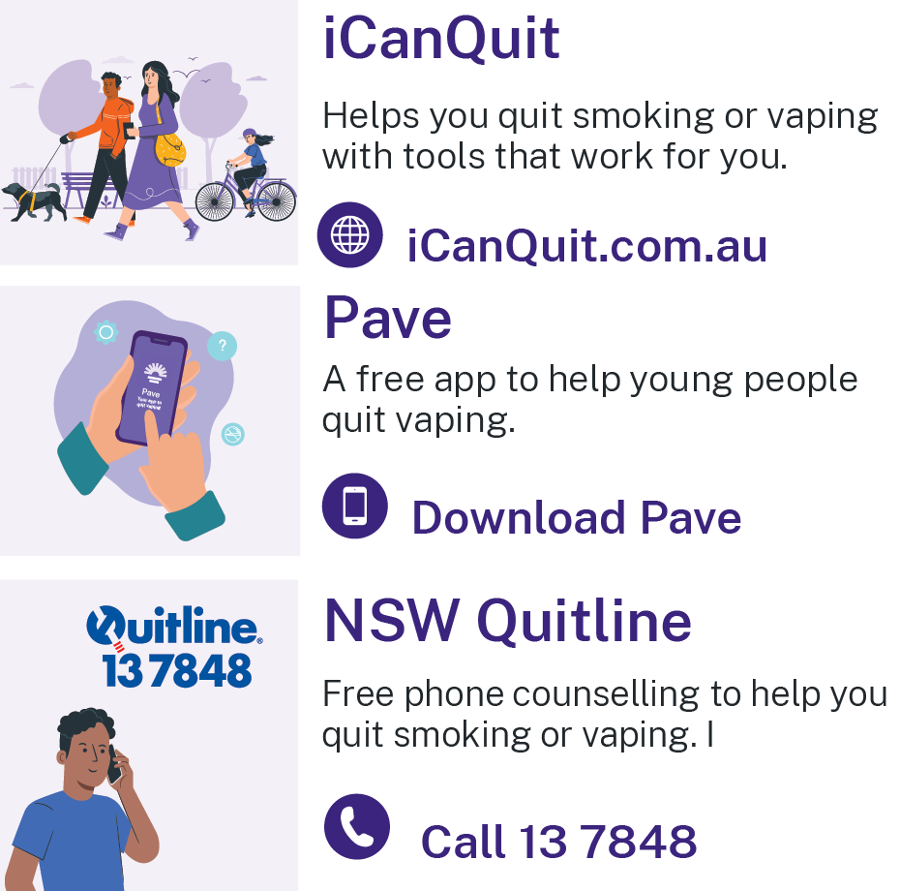
संसाधनहरु
Pave (पेभ) एप - एप्पल एप स्टोर वा गुगल प्लेबाट Pave (पेभ) डाउनलोड गर्नुहोस्
iCanQuit - iCanQuit.com.au
NSW Quitline - फोन 13 78 48
NSW Health Vaping Toolkit - www.health.nsw.gov.au/vaping
Shisha No Thanks
ShishaNoThanks.org.au
Notes:
Facilitator notes:
Please add a new slide if you wish to include additional resources and support.
Quit support services:
Pave app
Download Pave from the Apple App Store or Google Play.
iCanQuit
iCanQuit is a website which has in-language resources available.
Quitline
Free call 13 78 48.
Interpreters are available.
NSW Health Vaping Toolkit
There are resources in different languages for parents and carers.
www.health.nsw.gov.au/vaping
Shisha No Thanks
Website - ShishaNoThanks.org.au

Slide 22
धन्यवाद
Notes:
Facilitator note:
This email is for facilitators. If your group has any feedback on this presentation, please forward it to the Cancer Institute Prevention Team via email at CINSW-prevention@health.nsw.gov.au.

