Slide 1

與年輕人談論電子煙
家長與監護人指南

Slide 2

向原住民及其文化致敬
我向我們今天聚會所在土地的傳統守護者致敬。我向過去和現在的長老致敬，並讚頌原住民多元的文化，以及他們與新南威爾斯州土地和水域之間持續不斷的聯繫。
我也向今天出席的原住民和托雷斯海峽島民/同事致敬。
由 Dennis Golding 繪製
Notes:
Facilitator notes:
Please add a new slide if you wish to include your own local or organisational acknowledgement.

Slide 3
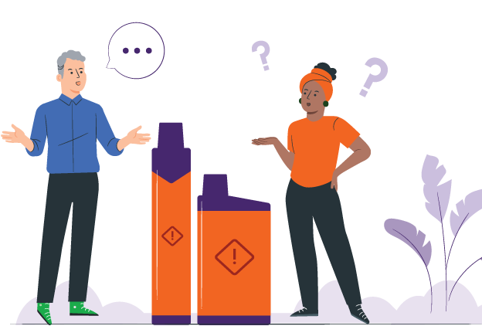
介紹
電子煙已變得越來越普遍
年輕人以不同的方式看待電子煙
從出於好奇，到決定是否要使用電子煙
家長和監護人可能不知道該說什麼
本指南旨在幫助你進行冷靜、簡單的對話
Notes:
Facilitator notes:
Vaping has become more common, and young people come across it in different ways. Some might just be curious. Some see friends or classmates vaping. Some may already be vaping. Others are choosing not to vape.
This guide is for all these situations. It helps parents and carers talk with young people, no matter where they are at.
You do not need to have all the answers. This guide is about listening, staying calm, and keeping the conversation open. It can help you support your young person and build trust over time.

Slide 4
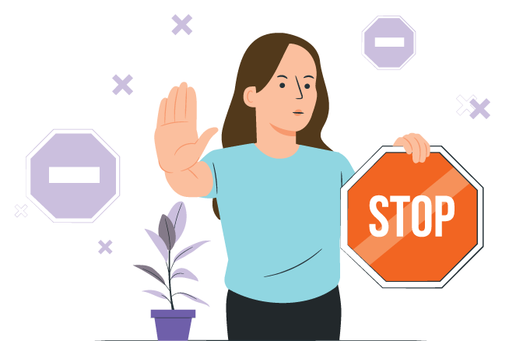
本指南的目的
幫助家長和監護人以安全且尊重的方式談論電子煙
防止年輕人開始吸食電子煙
支持年輕人戒除電子煙
建立信任和開放的溝通
Notes:
Facilitator notes:
The purpose of this guide is to support parents and carers to talk with young people about vaping in a safe and respectful way. It aims to encourage young people to avoid vaping, support those who may already be vaping to stop, and strengthen trust and communication. This guide is not about blaming or punishing young people.

Slide 5

如何使用本指南
你不需要一次用完整本指南
隨著時間推移談論電子煙
選擇適合你家庭和文化的部分
如果對話感到尷尬也沒關係
保持對話開放且具支持性
Notes:
Facilitator notes:
You don’t need to use the whole guide at once. Conversations about vaping can happen over time. Choose the parts that feel right for your family and your situation. It’s okay if things feel a bit awkward at first. What matters most is keeping the conversation open and supportive.

Slide 6

重點資訊：電子煙中的化學物質
大多數電子煙含有尼古丁
一支「6,000 口」電子煙中的尼古丁含量可能相當於 400 支香煙。
電子煙含有有害化學物質和重金屬
這些化學物質會傷害你的肺部、心臟和其他器官
吸食電子煙會造成傷害
Notes:
Facilitator notes:
Vapes contain nicotine and harmful chemicals
Nicotine is highly addictive and is found in most vapes
Regular use of nicotine often means people need more to get the same feeling from it. It can be hard to quit.
The nicotine in a 6,000 ‘puff’ vape can equal the same nicotine in 400 cigarettes
Vape liquid and aerosol contain harmful chemicals and metals like lead, nickel and chromium. These chemicals can damage the lungs, heart and other parts of the body. Some chemicals are also found in things like poisons and bug spray.

Slide 7

重點資訊：對健康的影響
吸食電子煙會將化學物質帶入肺部並導致呼吸問題
尼古丁會損害你的大腦
它會使學習、專注和管理情緒變得更加困難
吸食電子煙可能導致成癮，並增加你吸食香煙的機率
Notes:
Facilitator notes:
Vaping puts harmful chemicals into the body, which can damage your brain and cause breathing problems.
Most vapes contain nicotine, which is very addictive and can affect brain development in teenagers, making it harder to learn, focus, remember things, and manage emotions.
Some young people have even needed hospital care because of vaping.
Using vapes and cigarettes together can increase harm.
Research is still developing, but vaping has been linked to lung injury, mouth and throat problems, and possible cancer risks.
The long-term harms are still being studied.

Slide 8

重點資訊：澳洲法律
法律並未將自用電子煙使用者列為管制對象
法律並未將自用電子煙使用者列為管制對象
電子煙只可在藥房合法銷售
18歲以下的人需要獲得處方
大多數商店販售的電子煙都是非法的
使用私人用途的電子煙不會受到處罰
禁止吸煙的地方也禁止使用電子煙
Notes:
Facilitator notes:
In Australia:
Vapes can only legally be sold in pharmacies and should only be sold to help people quit smoking or to manage nicotine dependence.
People under 18 need a prescription to buy vapes from a pharmacy.
Shops such as tobacconists, service stations and convenience stores are banned from selling vapes.
People who have a vape for their own use are not targeted by the laws.
Vaping is banned in places where smoking is banned.
These laws apply across NSW and are in place to protect young people from addiction and health harm.

Slide 9

與年輕人對話的技巧
保持冷靜，不要批評
多聽少說
先提出開放式問題
表現出你理解他們的感受
Notes:
Facilitator notes:
When talking about vaping, staying calm and non‑judgemental can really help. Listening more than you talk shows your young person that you respect their thoughts and feelings. Even if you don’t fully agree, acknowledging how they feel can help them feel heard and more willing to listen.

Slide 10
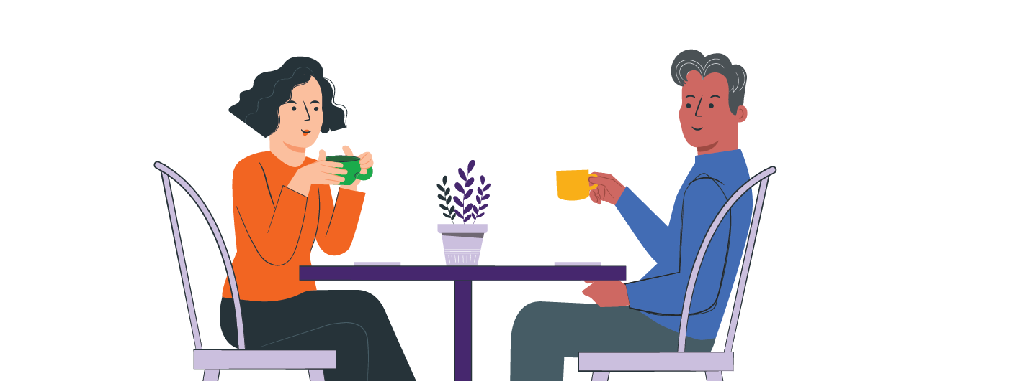
開始對話
選擇一個冷靜且安全的時機進行對話：
在進行日常活動（煮飯、散步）時並肩交談
當學校、社交媒體或電視上出現電子煙相關話題時
當你的孩子開始談論它時
簡單的開場方式
「我現在經常看到電子煙。你對此有什
麼看法？」
「你有看過或聽過關於電子煙的事嗎？」
Notes:
Facilitator notes:
It can help to start these conversations during everyday moments, like side-by-side activities instead of opposite each other (driving, cooking, or going for a walk). Try to keep the tone relaxed and curious. You might say something like, "I’ve been hearing about vaping lately and wanted to check in with you." Focusing on care rather than anger can help your young person open up.

Slide 11

為什麼年輕人可能會嘗試電子煙
好奇心
甜味或水果味
同儕壓力或想要融入群體
壓力、焦慮或應對情緒
在社交媒體上看到電子煙，讓人覺得這很正常
Notes:
Facilitator notes:
Young people may try vaping or shisha or other nicotine products for many reasons, including curiosity, sweet and fruity flavours, peer pressure, stress, or seeing vaping on social media. Some are also drawn to the short-term “head spin” or “buzz,” beliefs that vaping can help with weight control or appetite suppression, or the sense of privacy if parents or caregivers are less likely to notice. It’s normal for young people to be curious and want to fit in, and many are still learning how to cope with stress. Trying vaping does not mean a young person is bad or naughty, and it doesn’t mean they will keep using it.
What matters is how adults respond. Listening without judging, staying calm, and trying to understand their reasons can help build trust and support helpful conversations.

Slide 12
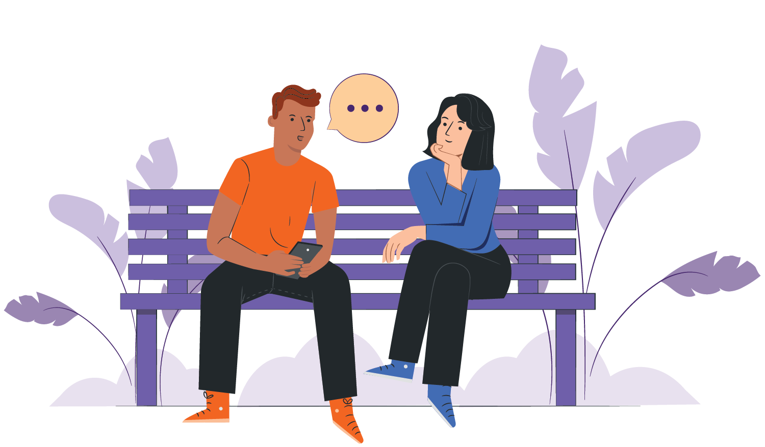
如果你的孩子沒有吸電子煙
支持他們不使用電子煙的選擇
討論如何應對同儕壓力
幫助他們練習說「不」
告訴他們隨時都可以來找你
Notes:
Facilitator notes:
If your young person is not vaping, this is a good chance to talk. Let them know you’re glad they’re not vaping and ask how they feel when others do. You can also practise simple responses like “No thanks, I don’t vape” or “I’m not into that” to help them feel confident saying no. You can also suggest it is fine for them to walk away too. These conversations can help them feel supported and prepared for situations where they may be offered a vape.

Slide 13
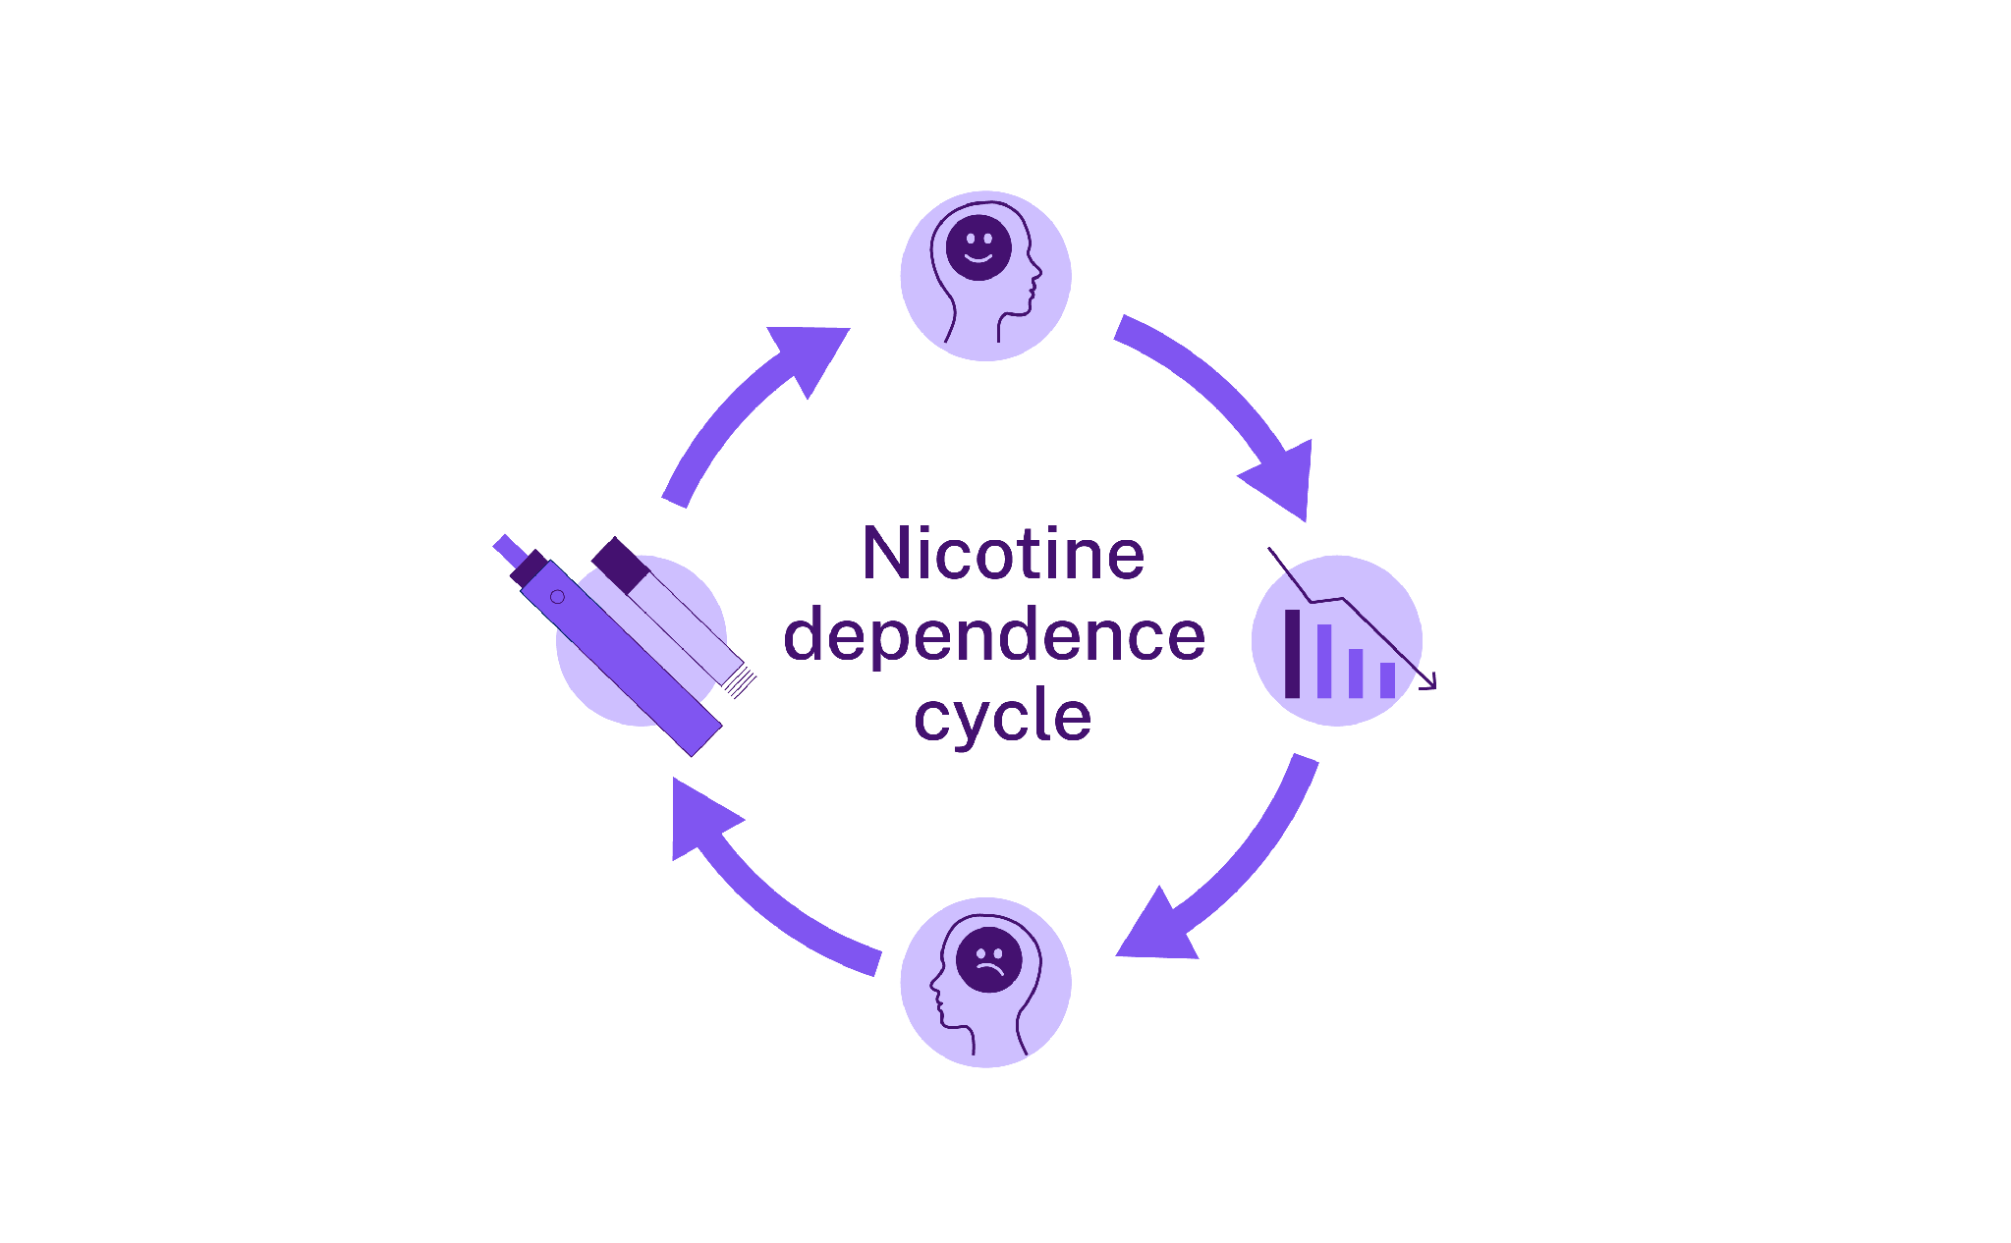
尼古丁與成癮
尼古丁會讓人上癮，並影響你的大腦
這會讓戒煙變得困難
年輕人的大腦仍在發育中
成癮可能發生得很快
尼古丁使大腦釋放多巴胺，這是一種「令人感覺良好」的化學物質
尼古丁透過吸煙或吸電子煙進入大腦
尼古丁
依賴循環
當多巴胺水平下降，會導致戒斷症狀
戒斷反應會增加再次吸煙或使用電子煙以獲取更多尼古丁的衝動
Notes:
Facilitator notes:
Nicotine affects the brain by releasing a feel-good chemical called dopamine. This can make people want to keep vaping to feel that effect again. Over time, the brain gets used to nicotine, making it harder to stop. Signs of addiction may include cravings, mood changes, feeling restless, trouble concentrating, or wanting to vape soon after waking up. Because young people’s brains are still developing, nicotine can cause long-lasting changes.

Slide 14

尼古丁與戒斷反應
當身體沒有獲得習慣的尼古丁量時，就會出
現戒斷反應
戒斷反應會導致情緒變化
症狀會在 1 到 2 週內改善
對尼古丁的渴望可能會持續更久
如果你吸煙或使用電子煙：​
坦誠相待對你的孩子有幫
助。這表明你了解戒煙的困難。努力保持健康可以樹立良好的榜樣。善待自己。改變需要時間。為自己尋求幫助也能幫助你的孩子。
Notes:
Facilitator notes:
When someone stops vaping, they may experience withdrawal symptoms like feeling moody, tired, anxious or finding it hard to concentrate. Withdrawal can happen during school hours, on long trips, or anytime vaping isn’t possible. The good news is that physical withdrawal usually improves within one to two weeks. Cravings can last longer as the brain learns to cope without nicotine, but it does get easier over time.
Parent & carer content:
If you smoke or vape yourself:
Being honest about your own experience can help your young person feel understood
Be kind to yourself. Change takes time and getting help for your own health can help you both

Slide 15
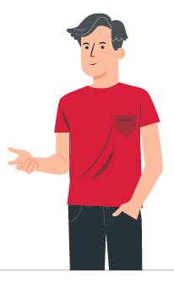
如果你的孩子正在使用電子煙
保持冷靜並傾聽
感謝他們的誠實
專注於他們的健康，而不是懲罰
詢問：
「你喜歡電子煙的哪一點？」
「你有想過要戒掉嗎？」
「你需要這方面的幫助嗎？」
如果你吸煙或使用電
子煙：
可以談論你自己的習
慣。你可以說你也在
努力戒煙。這表明戒煙雖然困難，但並非不可能。這有助於讓你的孩子感到被理解。
Notes:
Facilitator notes:
Finding out your young person is vaping can be upsetting. Taking a calm approach can make a big difference. Thanking them for being honest and focusing on health rather than punishment can help keep them talking and open to support. Some young people vape to cope with stress, anxiety, or fitting in, so it can help to encourage healthier options like exercise, creative activities, spending time with friends, or talking to a trusted adult.

Slide 16
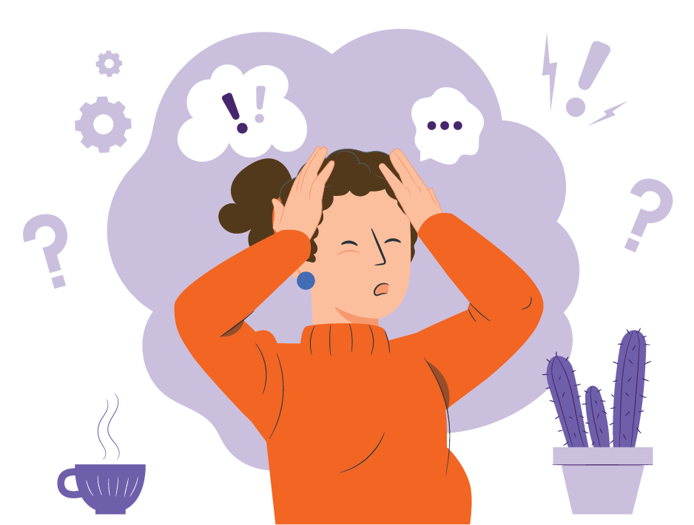
為什麼年輕人可能會使用電子煙：
如何應對
壓力：一些年輕人在有壓力時會使用
電子煙
融入群體：朋友可能會給年輕人壓力，讓他們使用電子煙
好奇心：嘗試使用電子煙可能會變成
一種習慣
隨處可見：電子煙在網路上看起來很
普遍
Notes:
Facilitator notes:
Young people may vape for many reasons. Knowing why can help you to support them.
Stress:
Some young people vape to cope with stress. Parents and carers can support them to find healthier ways to relax, like exercise, doing something creative, or talking about their feelings.
Fitting in:
Peer pressure can be strong. Remind young people that real friendships are about shared interests and support, not vaping.
Curiosity:
Trying new things is normal, but nicotine is very addictive. Even vaping “just once” can quickly turn into a habit or vaping more than they expected.
Seeing it everywhere:
Social media can make vaping seem normal or common, but around 80% of young people in NSW don’t vape, and many choose not to because it’s not harmless.

Slide 17
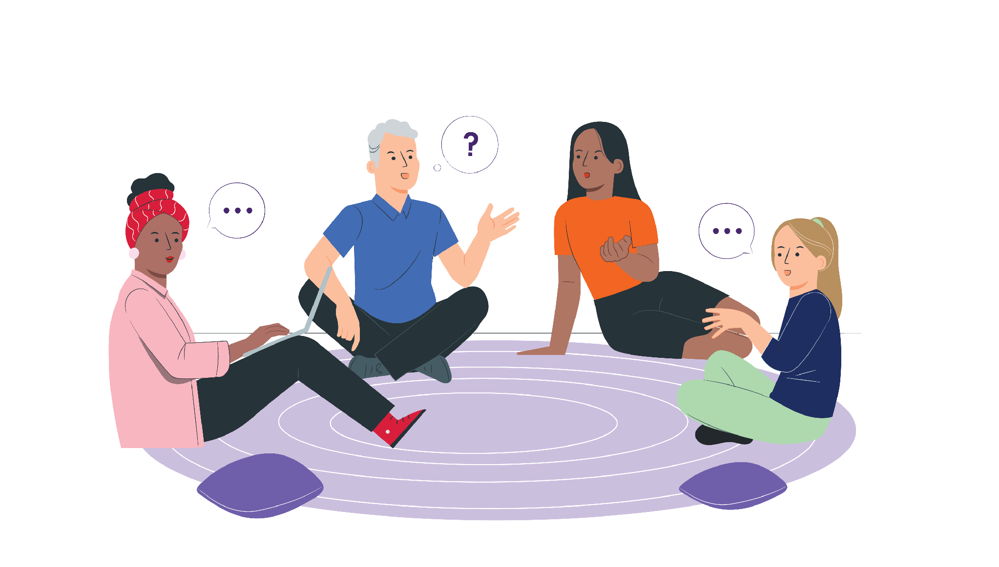
支持年輕人戒除電子煙
支持微小的進步
幫助應對渴望
避免批評他們
慶祝小小的勝利
如果他們還沒準備好戒除，請保持對話暢通
Notes:
Facilitator notes:
If they’re not ready to quit, focus on harm reduction and staying connected. This might include not vaping around others and planning for when they feel ready to make changes. Quitting can be hard, especially if nicotine addiction is involved, so encourage small steps and celebrate progress, even if it’s small. Relapse can happen and doesn’t mean failure. Ongoing support and trust really matter.
Parent & carer content:
Managing your own emotions
If you learn your young person is vaping, manage your feelings away from them
Strong reactions can make them shut down or pull away
Staying calm helps keep them open to support
If you smoke or vape, getting support can help you both

Slide 18

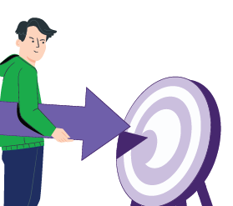


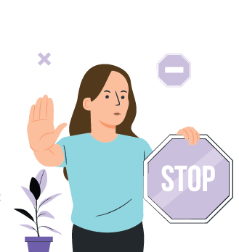



哪裡可以獲得幫助和支持
Pave
專為年輕人戒除電子煙設計的免費應用程式
下載 Pave
NSW Vaping Toolkit
為家長和監護人提供的可靠資訊
health.nsw.gov.au/vaping
iCanQuit
戒煙或戒除電子煙的免費網站
iCanquit.com.au/
Traditional-Chinese/
Shisha No Thanks
關於水煙危害的資訊
ShishaNoThanks.org.au
NSW Quitline
由受過培訓的輔導員提供的免費電話輔導服務
致電 13 7848
Notes:
Facilitator notes:
Support is available for both young people and families:
Pave is a free app created by Cancer Institute NSW to support young people who want to stop vaping. It provides tools and tips to help manage cravings and build confidence to quit. The app is designed specifically for young people and can be used independently or alongside other support. Download Pave from the Apple App Store or Google Play.
iCanQuit is a website that helps people stop smoking or vaping. It gives tools that you can choose to suit you. The website helps:
Make a quit plan
Stay motivated
Track your progress
Beat cravings
You can use iCanQuit on your own or with other support.
Quitline is a free and confidential phone service. It supports parents and carers as well as people who smoke or vape. Counsellors have been trained to listen without judgement and can help parents and carers to:
Start or continue conversations and handle tricky moments
Respond well if their young person is vaping
Advice is practical, respectful and tailored to each family’s situation. If you need an interpreter, they can arrange one for you when you call.
The NSW Health Vaping Toolkit is a NSW Health webpage with trusted information to help parents, carers, teachers and health staff talk to young people about vaping.
There are resources in different languages for parents and carers.
Shisha No Thanks is a website that helps adults learn about shisha (waterpipe) smoking. The website helps to:
Explain health harms
Clear up myths
Support talks with young people about shisha
There are translated c

Slide 19

持續對話
一次談話可能不夠
定期關心
持續傾聽並提供支持
持續且尊重的對話可以：
  減少傷害
  幫助你的孩子
Notes:
Facilitator notes:
Talking about vaping is not a one-off conversation. Checking in regularly and continuing to listen helps young people feel supported. These are guides, not rules, and every young person and family situation is different. Ongoing, respectful conversations can make a real difference and help reduce harm over time.

Slide 20

給家長和監護人的重點提示
你不需要成為專家
你與年輕人的關係最為重要
冷靜、開放的對話有幫助
多聽少說
你也可以獲得幫助
Notes:
Facilitator notes:
This guide offers ideas and support. There are many right ways to talk.
The main message is simple: stay connected, stay calm, and keep talking. You are not alone; there are services to help your family.

Slide 21

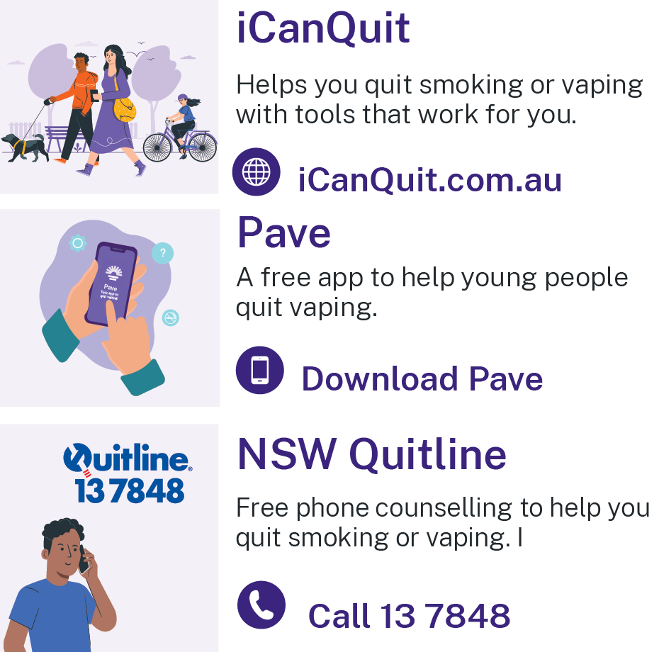
資源
Pave 應用程式 - 從 Apple App Store 或 Google Play 下載 Pave
iCanQuit - iCanQuit.com.au
NSW Quitline - 致電 13 78 48
NSW Health Vaping Toolkit - www.health.nsw.gov.au/vaping
Shisha No Thanks - ShishaNoThanks.org.au
Notes:
Facilitator notes:
Please add a new slide if you wish to include additional resources and support.
Quit support services:
Pave app
Download Pave from the Apple App Store or Google Play.
iCanQuit
iCanQuit is a website which has in-language resources available.
Quitline
Free call 13 78 48.
Interpreters are available.
NSW Health Vaping Toolkit
There are resources in different languages for parents and carers.
www.health.nsw.gov.au/vaping
Shisha No Thanks
Website - ShishaNoThanks.org.au

Slide 22
謝謝
Notes:
Facilitator note:
This email is for facilitators. If your group has any feedback on this presentation, please forward it to the Cancer Institute Prevention Team via email at CINSW-prevention@health.nsw.gov.au.

