Slide 1

与青少年谈论电子烟的问题
家长和照护人指南

Slide 2

国土承认声明
我向我们今天聚会所在土地的传统守护者致以敬意。我向过去和现在的长者表示敬意，并赞美原住民人民的多样性及其与新州土地和水域的持续文化和联系。
我也向今天参与我们讲座的原住民和托雷斯海峡岛民同胞/同事表示敬意。
本画作由 Dennis Golding 创作
Notes:
Facilitator notes:
Please add a new slide if you wish to include your own local or organisational acknowledgement.

Slide 3
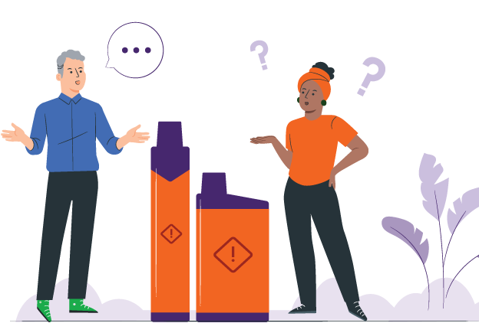
序言
电子烟已变得越来越普遍
青少年对电子烟的看法不尽相同
青少年可能对电子烟很好奇，但有的会选择吸电子烟，而有些会选择拒绝
家长和照护人可能不知道该对孩子说些什么
本指南旨在帮助您和孩子进行冷静、简单的交谈
Notes:
Facilitator notes:
Vaping has become more common, and young people come across it in different ways. Some might just be curious. Some see friends or classmates vaping. Some may already be vaping. Others are choosing not to vape.
This guide is for all these situations. It helps parents and carers talk with young people, no matter where they are at.
You do not need to have all the answers. This guide is about listening, staying calm, and keeping the conversation open. It can help you support your young person and build trust over time.

Slide 4

本指南的目的
帮助家长和照护人用安全且相互尊重的方式讨论电子烟
让尚未接触电子烟的青少年永远不碰第一口
支持青少年戒掉电子烟
建立相互之间的信任和坦诚的沟通
Notes:
Facilitator notes:
The purpose of this guide is to support parents and carers to talk with young people about vaping in a safe and respectful way. It aims to encourage young people to avoid vaping, support those who may already be vaping to stop, and strengthen trust and communication. This guide is not about blaming or punishing young people.

Slide 5

如何使用本指南
您无需一次性采用本指南的所有建议
谈论电子烟时可以慢慢来，循序渐进
选用指南中适合您家庭和文化的部分
觉得此类谈话比较尴尬也没关系
保持坦诚并给予支持最重要
Notes:
Facilitator notes:
You don’t need to use the whole guide at once. Conversations about vaping can happen over time. Choose the parts that feel right for your family and your situation. It’s okay if things feel a bit awkward at first. What matters most is keeping the conversation open and supportive.

Slide 6

小知识：电子烟中的化学物质
大多数电子烟含有尼古丁
一支可抽吸“6000 口”的电子烟中，尼古丁含量相当于 400 支香烟
电子烟含有有害化学物质和重金属
这些化学物质会伤害您的肺部、心脏和其他器官
吸电子烟会造成伤害
Notes:
Facilitator notes:
Vapes contain nicotine and harmful chemicals
Nicotine is highly addictive and is found in most vapes
Regular use of nicotine often means people need more to get the same feeling from it. It can be hard to quit.
The nicotine in a 6,000 ‘puff’ vape can equal the same nicotine in 400 cigarettes
Vape liquid and aerosol contain harmful chemicals and metals like lead, nickel and chromium. These chemicals can damage the lungs, heart and other parts of the body. Some chemicals are also found in things like poisons and bug spray.

Slide 7

小知识：健康影响
吸电子烟会将化学物质带入肺部并导致呼吸问题
尼古丁会损伤您的大脑
它会为学习、专注力和管理情绪带来负面影响
吸电子烟可能会上瘾，并增加您日后吸香烟的可能性
Notes:
Facilitator notes:
Vaping puts harmful chemicals into the body, which can damage your brain and cause breathing problems.
Most vapes contain nicotine, which is very addictive and can affect brain development in teenagers, making it harder to learn, focus, remember things, and manage emotions.
Some young people have even needed hospital care because of vaping.
Using vapes and cigarettes together can increase harm.
Research is still developing, but vaping has been linked to lung injury, mouth and throat problems, and possible cancer risks.
The long-term harms are still being studied.

Slide 8

小知识：澳大利亚相关法律
法律针对的不是自行吸电子烟的个人
法律针对的不是自行吸电子烟的个人
只有药房才能合法销售电子烟
未满 18 岁的青少年需要处方才能购买
商店里出售的大多数电子烟都是非法的
个人自行吸电子烟不会惹上麻烦
禁止吸烟的场所也禁止吸电子烟
Notes:
Facilitator notes:
In Australia:
Vapes can only legally be sold in pharmacies and should only be sold to help people quit smoking or to manage nicotine dependence.
People under 18 need a prescription to buy vapes from a pharmacy.
Shops such as tobacconists, service stations and convenience stores are banned from selling vapes.
People who have a vape for their own use are not targeted by the laws.
Vaping is banned in places where smoking is banned.
These laws apply across NSW and are in place to protect young people from addiction and health harm.

Slide 9

与青少年谈话的技巧
保持冷静，不要评判
多听少说
先问一些没有既定答案的问题
向他们表示您理解他们的感受
Notes:
Facilitator notes:
When talking about vaping, staying calm and non‑judgemental can really help. Listening more than you talk shows your young person that you respect their thoughts and feelings. Even if you don’t fully agree, acknowledging how they feel can help them feel heard and more willing to listen.

Slide 10
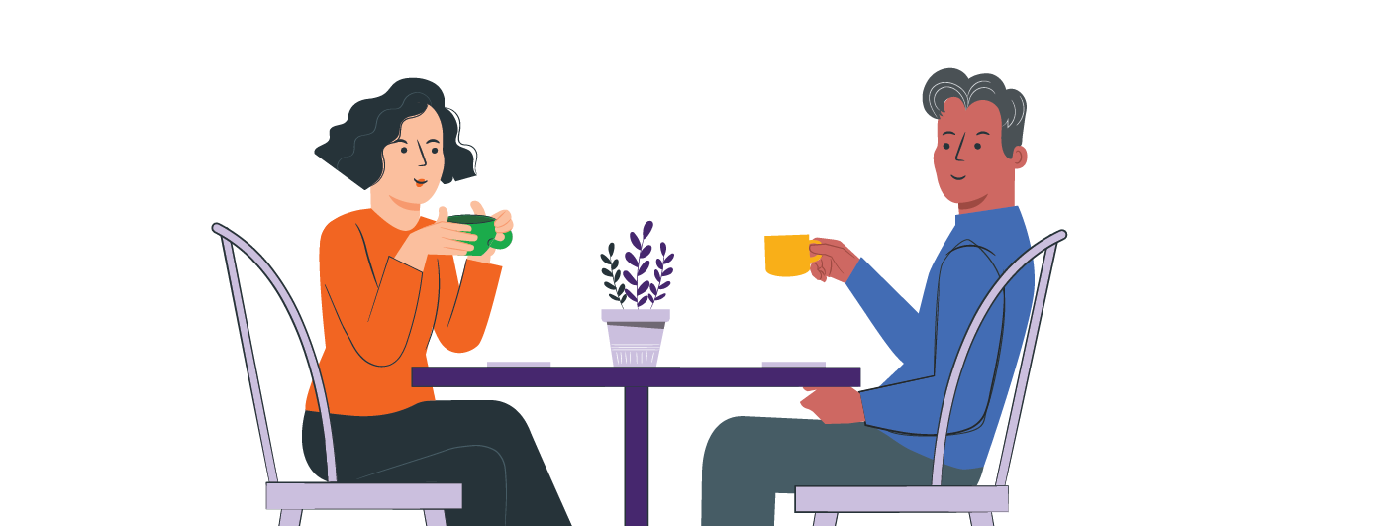
开始对话
选择一个安全且双方都比较冷静的时间进行交谈：
在并肩进行日常活动（做饭、散步）
时交谈
当学校、社交媒体或电视上出现电子烟话题时借机开启对话
当您的孩子开始谈论电子烟时
简单的对话打开方式
“我现在经常看到(有人吸)电子烟。
你对此怎么看呢？”
“你有没有看到或听到过关于吸电子烟的情况？”
Notes:
Facilitator notes:
It can help to start these conversations during everyday moments, like side-by-side activities instead of opposite each other (driving, cooking, or going for a walk). Try to keep the tone relaxed and curious. You might say something like, "I’ve been hearing about vaping lately and wanted to check in with you." Focusing on care rather than anger can help your young person open up.

Slide 11

青少年可能尝试电子烟的原因
好奇心
电子烟的甜味或果味
同伴压力或想要合群
压力、焦虑或应对情绪上的问题
因为经常在社交媒体上看到电子烟而认为这很正常
Notes:
Facilitator notes:
Young people may try vaping or shisha or other nicotine products for many reasons, including curiosity, sweet and fruity flavours, peer pressure, stress, or seeing vaping on social media. Some are also drawn to the short-term “head spin” or “buzz,” beliefs that vaping can help with weight control or appetite suppression, or the sense of privacy if parents or caregivers are less likely to notice. It’s normal for young people to be curious and want to fit in, and many are still learning how to cope with stress. Trying vaping does not mean a young person is bad or naughty, and it doesn’t mean they will keep using it.
What matters is how adults respond. Listening without judging, staying calm, and trying to understand their reasons can help build trust and support helpful conversations.

Slide 12

如果您的孩子没有在吸电子烟
支持他们不吸电子烟的选择
谈谈如何应对同伴压力
帮助他们练习拒绝（说“不”）
告诉他们随时可以找您沟通
Notes:
Facilitator notes:
If your young person is not vaping, this is a good chance to talk. Let them know you’re glad they’re not vaping and ask how they feel when others do. You can also practise simple responses like “No thanks, I don’t vape” or “I’m not into that” to help them feel confident saying no. You can also suggest it is fine for them to walk away too. These conversations can help them feel supported and prepared for situations where they may be offered a vape.

Slide 13
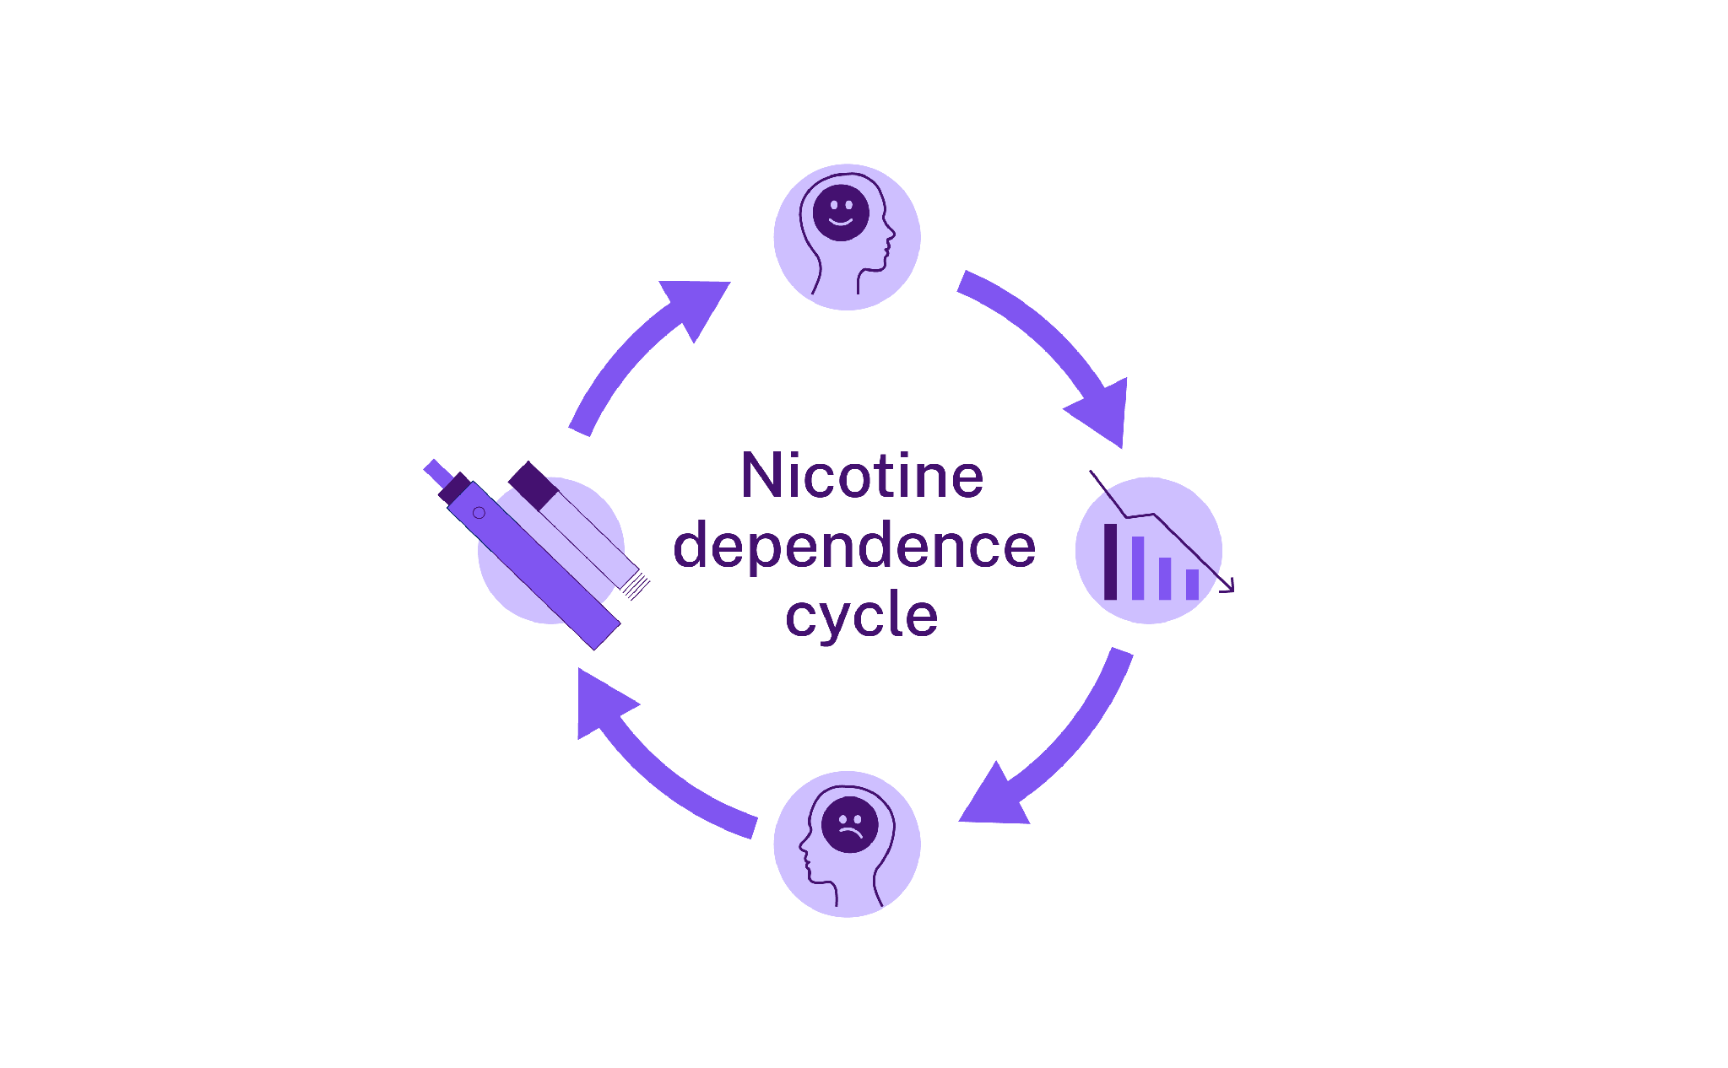
尼古丁和成瘾问题
尼古丁会让人上瘾并影响您的大脑
这会为戒烟增加难度
青少年的大脑仍在发育中
上瘾可能会很快
尼古丁使大脑释放多巴胺，这是一种让人“感觉良好”的化学物质
尼古丁通过吸烟或吸电子烟进入大脑
尼古丁的依赖循环
多巴胺水平下降时，会导致戒断症状
戒断反应增加了再次吸烟或吸电子烟以摄取更多尼古丁的冲动
Notes:
Facilitator notes:
Nicotine affects the brain by releasing a feel-good chemical called dopamine. This can make people want to keep vaping to feel that effect again. Over time, the brain gets used to nicotine, making it harder to stop. Signs of addiction may include cravings, mood changes, feeling restless, trouble concentrating, or wanting to vape soon after waking up. Because young people’s brains are still developing, nicotine can cause long-lasting changes.

Slide 14

尼古丁与戒断反应
当身体没有获得已经习惯的尼古丁时，就会
发生戒断反应
戒断反应会导致情绪变化
症状在 1 至 2 周内会有所改善
想吸烟的念头可能会持续更长时间
如果您自己也吸烟或吸电
子烟：​
坦诚谈论您自己的情况可以帮助您的孩子。这表明您了解戒烟有多难。自己努力保持健康可以为孩子树立一个好榜样。善待自己。改变需要时间。为您自己寻求帮助也可以帮助您的孩子。
Notes:
Facilitator notes:
When someone stops vaping, they may experience withdrawal symptoms like feeling moody, tired, anxious or finding it hard to concentrate. Withdrawal can happen during school hours, on long trips, or anytime vaping isn’t possible. The good news is that physical withdrawal usually improves within one to two weeks. Cravings can last longer as the brain learns to cope without nicotine, but it does get easier over time.
Parent & carer content:
If you smoke or vape yourself:
Being honest about your own experience can help your young person feel understood
Be kind to yourself. Change takes time and getting help for your own health can help you both

Slide 15
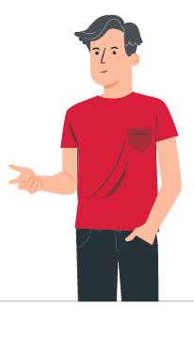
如果您的孩子现在有吸电子烟的情况
保持冷静并倾听孩子诉说
感谢他们对您诚实相待
把重点放在他们的健康上，而不是一味想着施加惩罚
询问：
“你为什么喜欢吸电子烟？”
“你有想过戒掉吗？”
“你需要这方面的帮助吗？”
如果您自己也吸烟或吸电子烟：
您可以谈论自己的习惯。您可以说您也在努力戒烟。这可以向孩子表明戒烟很难，但并非不可能。这有助于让您的孩子感到自己得到理解。
Notes:
Facilitator notes:
Finding out your young person is vaping can be upsetting. Taking a calm approach can make a big difference. Thanking them for being honest and focusing on health rather than punishment can help keep them talking and open to support. Some young people vape to cope with stress, anxiety, or fitting in, so it can help to encourage healthier options like exercise, creative activities, spending time with friends, or talking to a trusted adult.

Slide 16
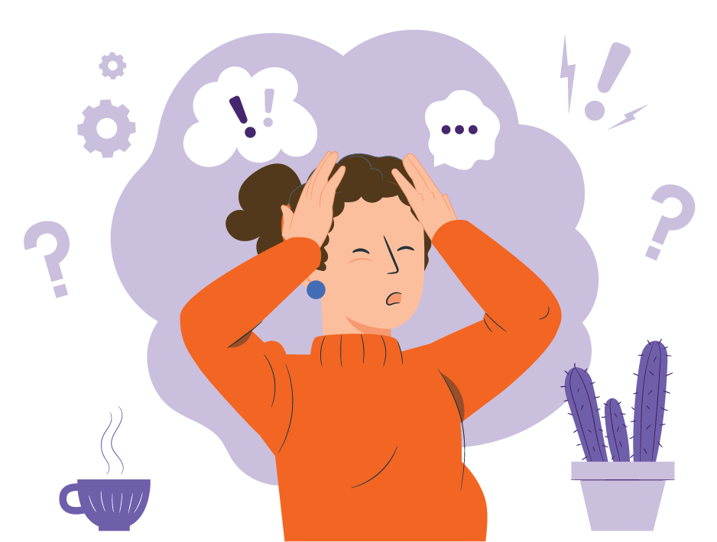
青少年为什么会吸电子烟：
如何应对
压力：有些青少年在感到压力时会吸电子烟
合群：孩子的朋友可能会给他们压力，让他们吸电子烟
好奇心：一开始只是尝试吸电子烟，
但后来变成了习惯
随处可见：电子烟在网上看起来很普遍
Notes:
Facilitator notes:
Young people may vape for many reasons. Knowing why can help you to support them.
Stress:
Some young people vape to cope with stress. Parents and carers can support them to find healthier ways to relax, like exercise, doing something creative, or talking about their feelings.
Fitting in:
Peer pressure can be strong. Remind young people that real friendships are about shared interests and support, not vaping.
Curiosity:
Trying new things is normal, but nicotine is very addictive. Even vaping “just once” can quickly turn into a habit or vaping more than they expected.
Seeing it everywhere:
Social media can make vaping seem normal or common, but around 80% of young people in NSW don’t vape, and many choose not to because it’s not harmless.

Slide 17
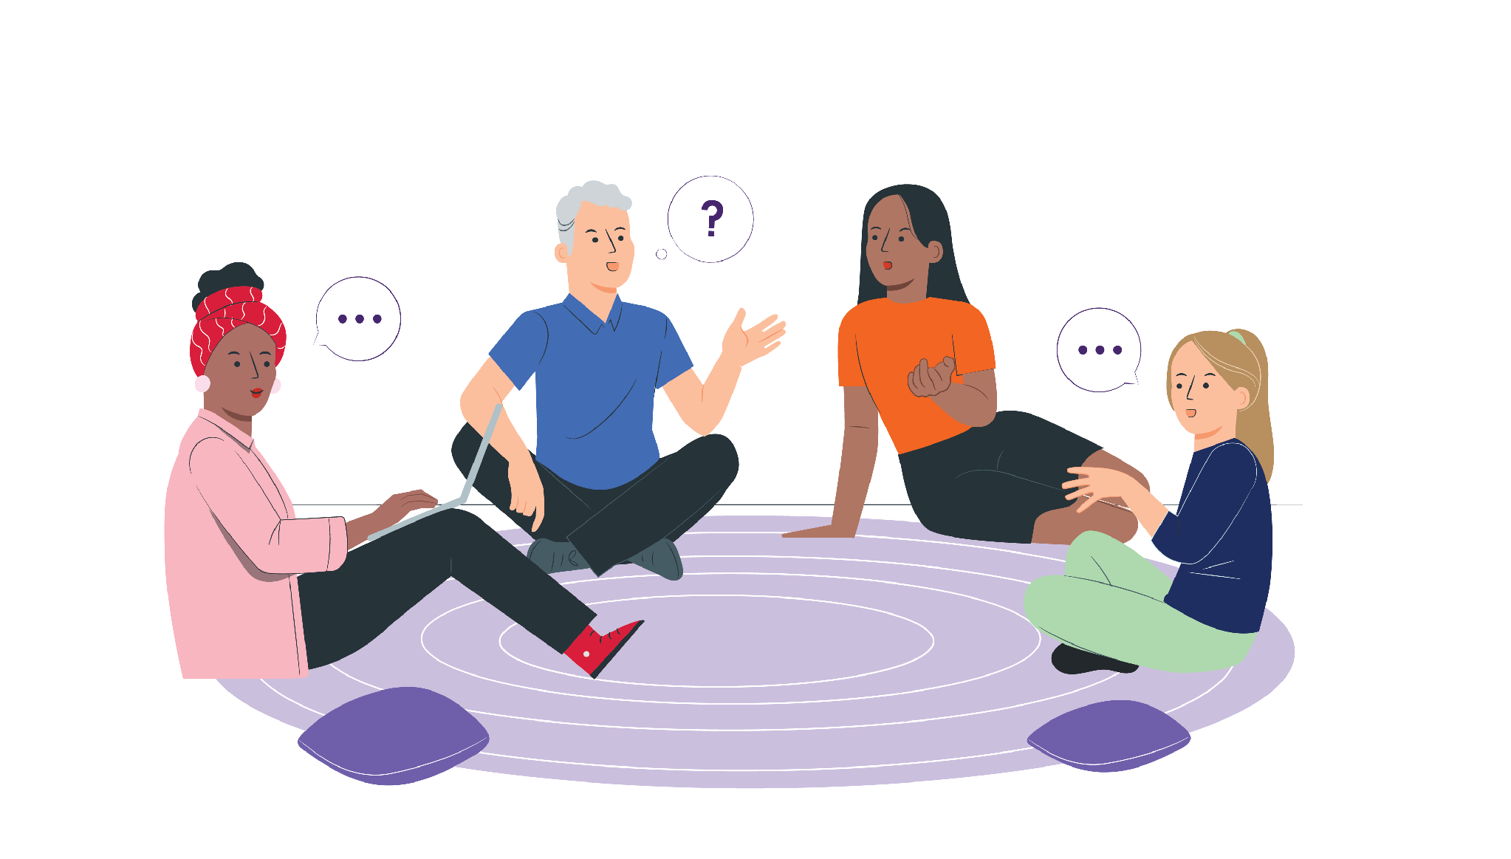
支持青少年戒掉电子烟
支持戒烟的每一小步
帮助孩子应对烟瘾
避免苛责他们
庆祝每一个小胜利
如果他们还没准备好戒烟，保持坦诚的对话
Notes:
Facilitator notes:
If they’re not ready to quit, focus on harm reduction and staying connected. This might include not vaping around others and planning for when they feel ready to make changes. Quitting can be hard, especially if nicotine addiction is involved, so encourage small steps and celebrate progress, even if it’s small. Relapse can happen and doesn’t mean failure. Ongoing support and trust really matter.
Parent & carer content:
Managing your own emotions
If you learn your young person is vaping, manage your feelings away from them
Strong reactions can make them shut down or pull away
Staying calm helps keep them open to support
If you smoke or vape, getting support can help you both

Slide 18

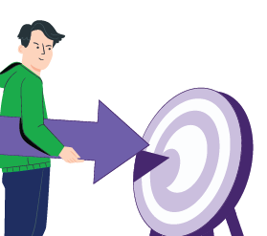


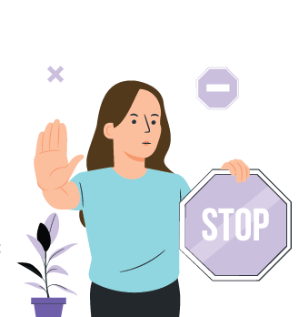



在哪里获取帮助与支持
Pave
帮助青少年戒电子烟的免费应用程序
下载 Pave
NSW Vaping Toolkit
（新州电子烟戒断工具包）
为家长和照护人提供的可靠信息
health.nsw.gov.au/vaping
iCanQuit
戒烟或戒电子烟
的免费网站
iCanQuit.com.au/Simplified-Chinese/
Shisha No Thanks
关于水烟危害的信息
ShishaNoThanks.org.au
NSW Quitline（新南威尔士州戒烟热线）
由受过培训的心理咨询师提供的免费电话支持
请致电 13 7848
Notes:
Facilitator notes:
Support is available for both young people and families:
Pave is a free app created by Cancer Institute NSW to support young people who want to stop vaping. It provides tools and tips to help manage cravings and build confidence to quit. The app is designed specifically for young people and can be used independently or alongside other support. Download Pave from the Apple App Store or Google Play.
iCanQuit is a website that helps people stop smoking or vaping. It gives tools that you can choose to suit you. The website helps:
Make a quit plan
Stay motivated
Track your progress
Beat cravings
You can use iCanQuit on your own or with other support.
Quitline is a free and confidential phone service. It supports parents and carers as well as people who smoke or vape. Counsellors have been trained to listen without judgement and can help parents and carers to:
Start or continue conversations and handle tricky moments
Respond well if their young person is vaping
Advice is practical, respectful and tailored to each family’s situation. If you need an interpreter, they can arrange one for you when you call.
The NSW Health Vaping Toolkit is a NSW Health webpage with trusted information to help parents, carers, teachers and health staff talk to young people about vaping.
There are resources in different languages for parents and carers.
Shisha No Thanks is a website that helps adults learn about shisha (waterpipe) smoking. The website helps to:
Explain health harms
Clear up myths
Support talks with young people about shisha
There are translated c

Slide 19

保持沟通
只沟通一次可能不够
定期沟通
不断倾听并提供支持
持续且相互尊重的对话可以：
  减少伤害
  为您的孩子提供帮助
Notes:
Facilitator notes:
Talking about vaping is not a one-off conversation. Checking in regularly and continuing to listen helps young people feel supported. These are guides, not rules, and every young person and family situation is different. Ongoing, respectful conversations can make a real difference and help reduce harm over time.

Slide 20

家长和照护人需要了解的要点
您不需要成为这方面的专家
您与孩子之间的亲子关系最为重要
冷静、坦诚的对话会有所帮助
多听少说
您也可以为自己寻求支持
Notes:
Facilitator notes:
This guide offers ideas and support. There are many right ways to talk.
The main message is simple: stay connected, stay calm, and keep talking. You are not alone; there are services to help your family.

Slide 21

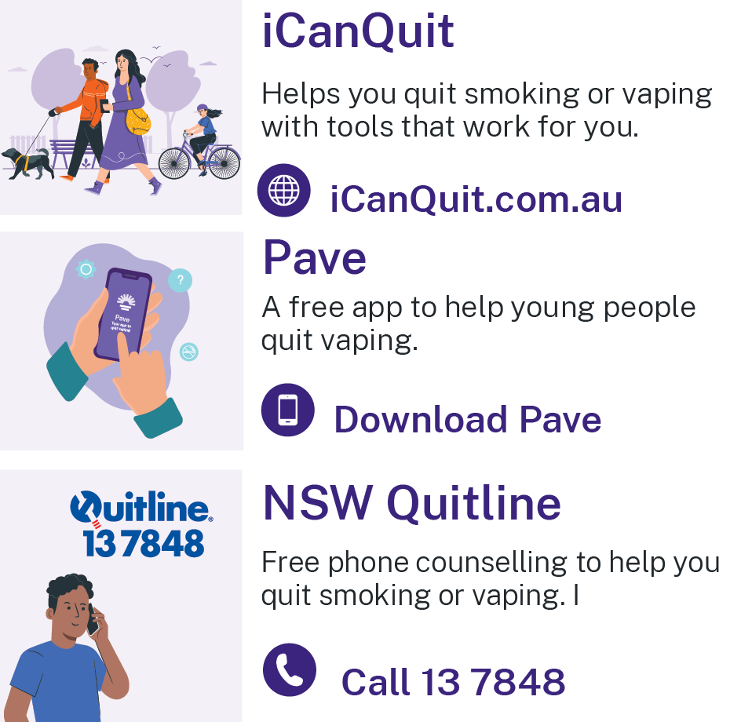
资源
Pave 应用程序 - 从 Apple App Store 或 Google Play 下载 Pave
iCanQuit - iCanQuit.com.au
NSW Quitline - 致电 13 78 48
NSW Health Vaping Toolkit - www.health.nsw.gov.au/vaping
Shisha No Thanks
ShishaNoThanks.org.au
Notes:
Facilitator notes:
Please add a new slide if you wish to include additional resources and support.
Quit support services:
Pave app
Download Pave from the Apple App Store or Google Play.
iCanQuit
iCanQuit is a website which has in-language resources available.
Quitline
Free call 13 78 48.
Interpreters are available.
NSW Health Vaping Toolkit
There are resources in different languages for parents and carers.
www.health.nsw.gov.au/vaping
Shisha No Thanks
Website - ShishaNoThanks.org.au

Slide 22
感谢您的参与
Notes:
Facilitator note:
This email is for facilitators. If your group has any feedback on this presentation, please forward it to the Cancer Institute Prevention Team via email at CINSW-prevention@health.nsw.gov.au.

